Slide 1

POST Learning Portal Overview
Portal Support Team
support@postportal.atlassian.net
916-970-4650
EDI Help
EDI@post.ca.gov
916-275-5872
California Commission on
Peace Officer Standards and Training
Notes:
PowerPoint updated May 2025
LP Help Phone: 916-970-4650
EDI Help Phone: 916-275-5872

Slide 2
What We’ll
Cover Today
Learning Portal Basics
Products Recently Released and in Production
Hands-on Activities
Training Manager Tools
Learning Portal Help
Notes:
Think about what else you might need to know. (Entering rosters in EDI, VPP status, Assigning Training are common requests.)

Slide 3
POST
Learning
Portal
  What?
  Training Courses, Informational Resources, Tutorials
  Why?
  Free, 24/7 Access, Meet Mandates, Manage Learners, Assign Training, Run Reports
  Where?
  www.lp.post.ca.gov
  How?
  PASS account plus either: Sworn Staff/NOA, Dispatchers, or manually added Non-Peace Officers
Notes:
Learning Portal :
What: Courses, Informational Resources, Tutorials
Why: Free, 24/7 Access, Meet Mandates, Manage Learners, Assign Training, Run Reports
Where: From POST Website or Direct URL
How: PASS account, Sworn Staff/NOA, Non-Peace Officers
The Learning Portal is a free, secure website for California peace officers, dispatchers, and law enforcement instructors. It provides 24/7 access to many of the products developed by LTR. It’s one option for training and video resources. What are you using it for?
Distance learning including self-paced courses and training videos to be facilitated/discussed and an EDI roster to be entered. Video topics and resources are available to train with.
Did You Know? Series - provides short, informational videos that can be used for roll call training or assigned for general information. Agencies small to medium sized a huge benefit.
Many courses meet mandates, including most products meet the 24 hour every 2 years CPT credit requirement.
Tutorials and informational segments provide support and reference. Some distance learning course completions are automatically posted to the student’s POST training profile for Continuing Professional Training (CPT) credit. Details about CPT credit for each product is provided in the Learning Portal description for each topic.

Slide 4
Recently Released or
In Progress
  Legal update content
    Domestic Violence Response Update
    Gun Violence Restraining Orders
  Peace Officer Certification and Decertification
  Preliminary Investigation and Evidence
  Responding to Behavioral Health Conditions
  Science-Based Interviewing
  First Aid/CPR/AED Replacement
  PSP: Strategic Communications Updates

Slide 5
How Tos
Interface and Terminology
Find, Register For, and Drop Courses
Others (VPP, NPOs, Rosters)
Learner and Manager Navigation
Manager Tools (Assign Training, Run Reports)
Notes:
Who is a LP Admin with Manager role?

Slide 6
Activity
Sign-in Page Information

Slide 7
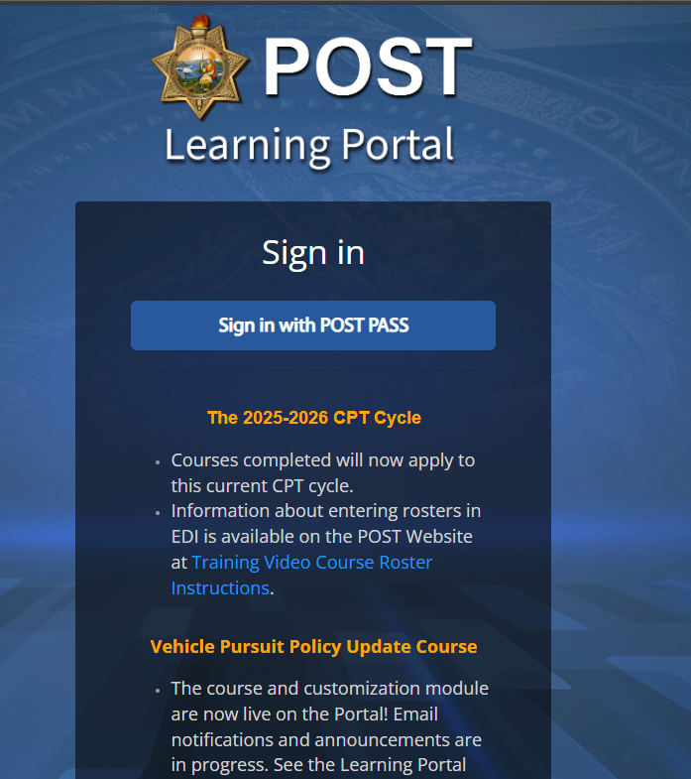
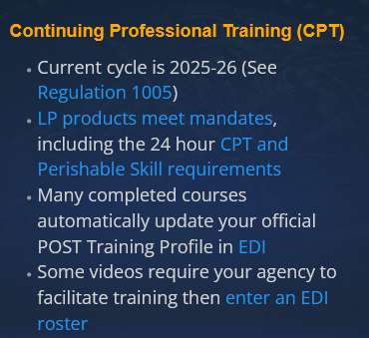
Sign In
Go to https://lp.post.ca.gov
Watch for Portal Status Alerts (Info, downtime, new releases)
Quick links to info and help
Portal Support at bottom
Click Sign in with POST PASS
See Info & Updates
Notes:
Sign in:
Go to https://lp.post.ca.gov
Portal Status – Downtime, new releases
Click “Learning Portal Status Update Page”
Portal Support
Sign in with POST PASS

Slide 8
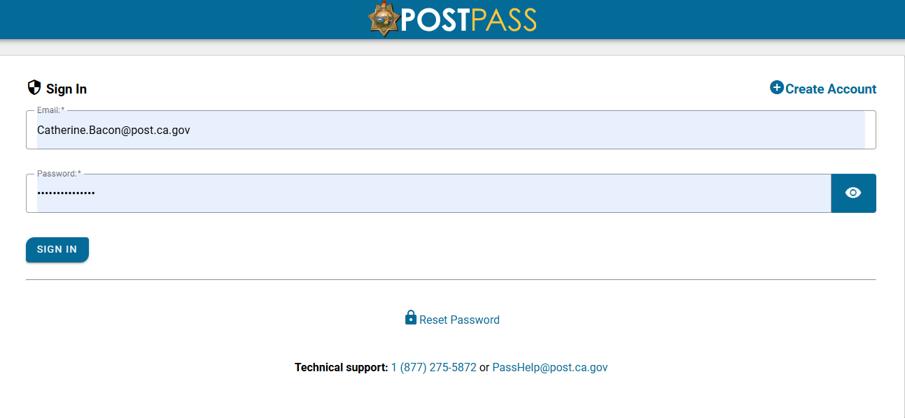
Sign In
Go to https://lp.post.ca.gov
Watch for Portal Status Alerts (downtime, new releases)
Quick link to Entering Rosters
Portal Support at bottom
Click Sign in with POST PASS

Slide 9
Learning Portal Terms
Term | Meaning
Dashboard | Where you land when you login
Active Courses | Courses you are enrolled in (Dashboard)
Completed Courses | Find completion certificates. Download all, if needed. (Dashboard)
Pending & Learning Paths | Aren’t used right now (Dashboard)
Enrollment | Active registration in a course from Register for Courses or when assigned a course. New quarterly enrollments starting July
Affiliation | Agency or Group access to resources
Role | Who you are in the system and permissions you have
Course | Title or topic for training
Section | A breakdown of the course enrollments by CPT Cycle. Ends Dec 31, 2026.
Notes:
These are terms referred to in the Portal
Explain new quarterly enrollments

Slide 10
Activity
Learner View and Register for Courses

Slide 11
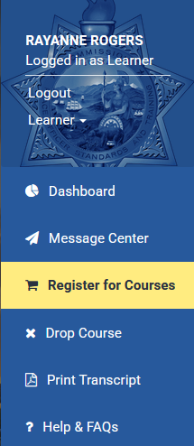
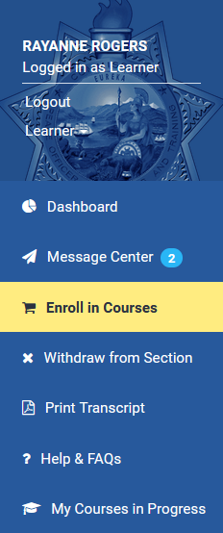
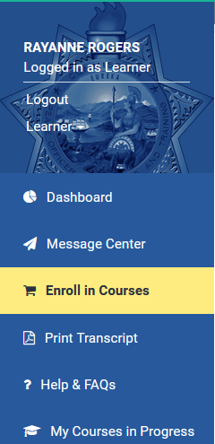
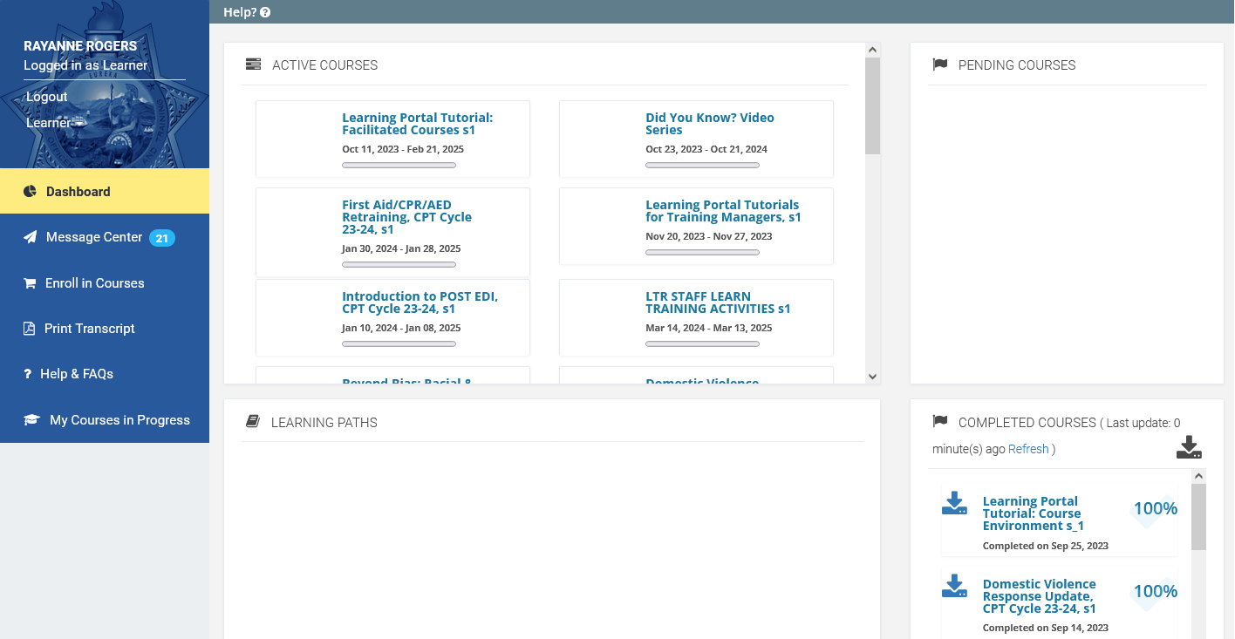
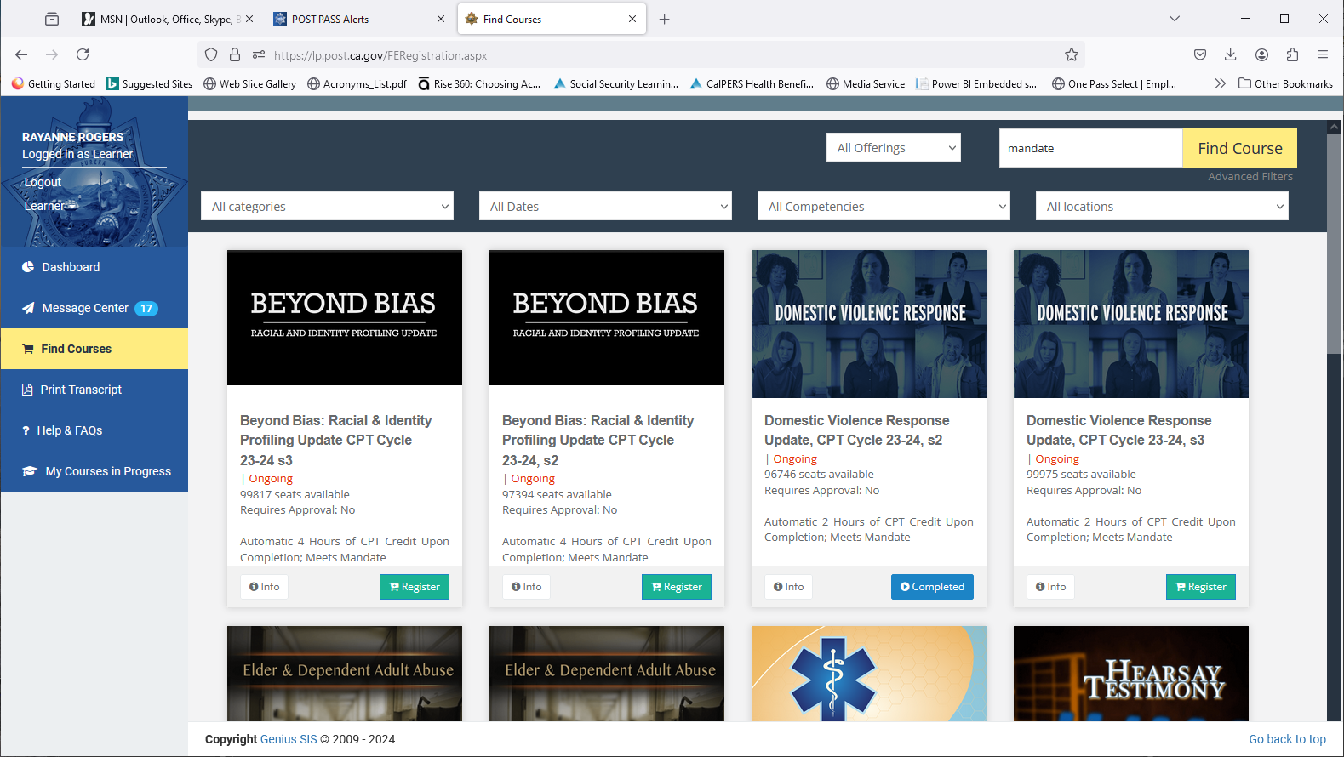
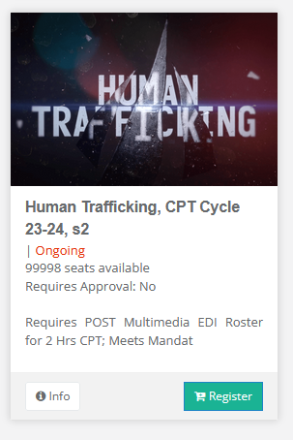
Click Register for Courses
Many Topics
Some Meet Mandates
Continuing Professional Training (CPT)
Notes:
You are on your Dashboard as a Learner which is the default.
Once a Learner is enrolled the course section will appear in their dashboard.
Message Center shows the enrollment and other messages from the Portal including course completions.
Look at your active courses. If you are already an LP Admin you were assigned the training manager tutorials and the facilitated courses. Those are in your dashboard to learn from and/or use for training.
The complete courses corner has your certificates of completion. You can download them all.
(Common Question: Can I download others? No. Transcripts give you some similar info and we’ll go over that when we change to your training manager role)
Let’s find the other courses to take, click Register for Courses for the catalog of additional courses.

Slide 12
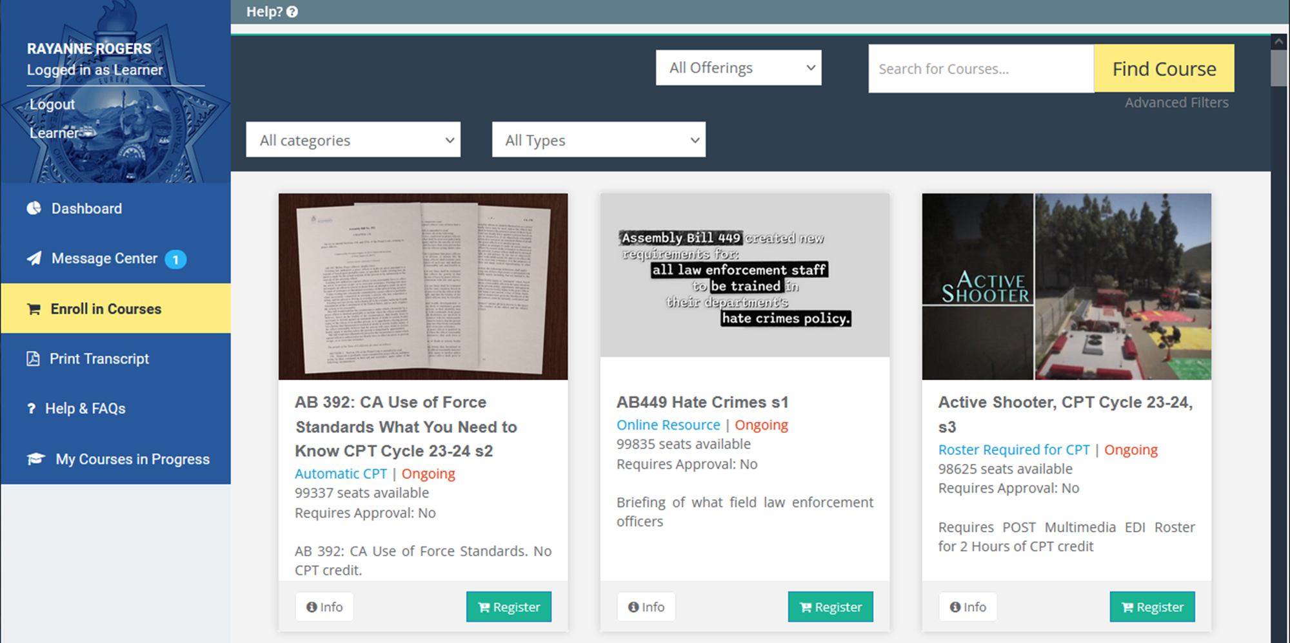
Automatic CPT
Online Resource
Roster Required for CPT
Notes:
Under Register for Courses (the online course catalog), there are many topics, most meet CPT mandates, some meet specific mandates, facilitated video training programs can help for group settings and there are individual version too but those still need to be discussed, did you know videos.
Each “card” indicates if automatic CPT is offered or if a multimedia roster to be entered in EDI for credit.
The automatic CPT training has quizzes/tests, interactions, and feedback as if an instructor is involved but they are self-paced.
The training that requires an EDI roster has a companion facilitated version, student guide, and overview guide PDFs that you as a training manager with LP admin access can discuss or facilitate a session or have a discussion. Or point an instructor to teach from. There’s where you are responsible to ensure learning took place. There are guides for facilitation, student participation and an over of a topic. We’ll go over where those are.
Also can find mandates on the website. I have a link to this later. https://post.ca.gov/Learning-Portal-Training-that-Meets-Mandates

Slide 13
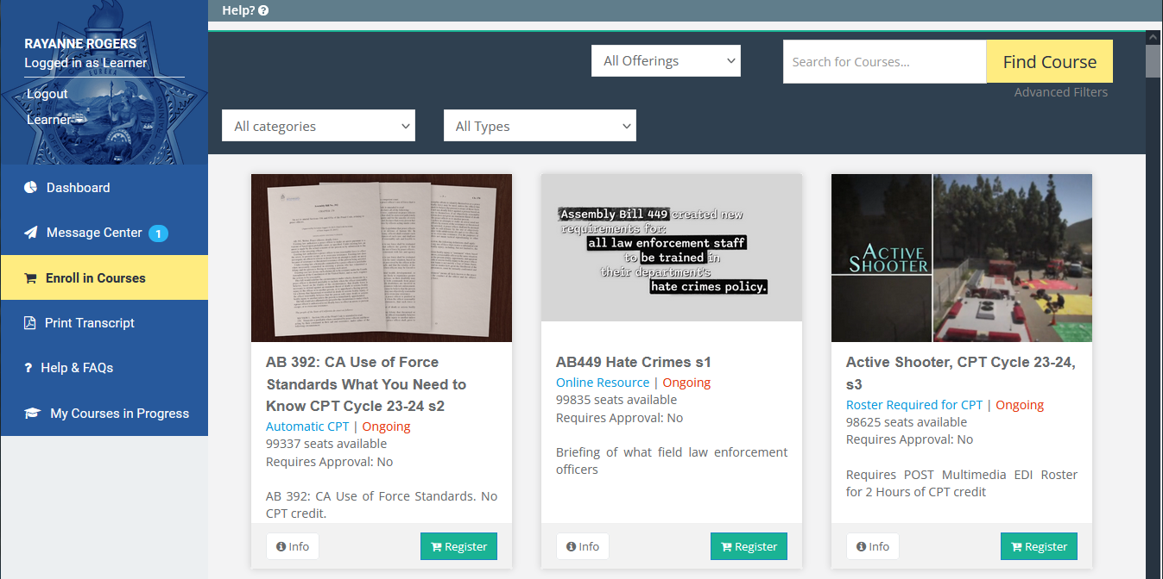
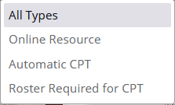
Click on
All Types
Notes:
To help you find what you need, there are a few ways to filter and search. Categories and types can help. Example: Automatic CPT
The search features now have more detail such as “roster required”, “mandates”

Slide 14
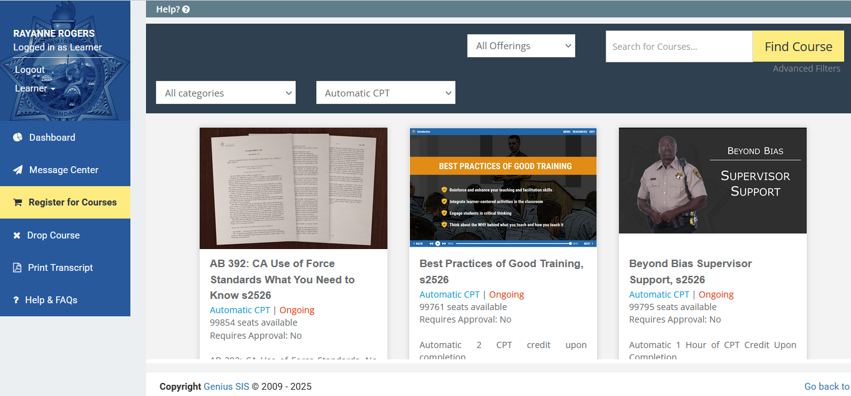
Enter the word “mandate” in Search
Click Find Course
Notes:
You can also search for topics or categories. Enter “mandate” in Search to see the courses that meet mandates.
Sidebar: Also, can find mandates on the website. I have a link to this later. https://post.ca.gov/Learning-Portal-Training-that-Meets-Mandates

Slide 15
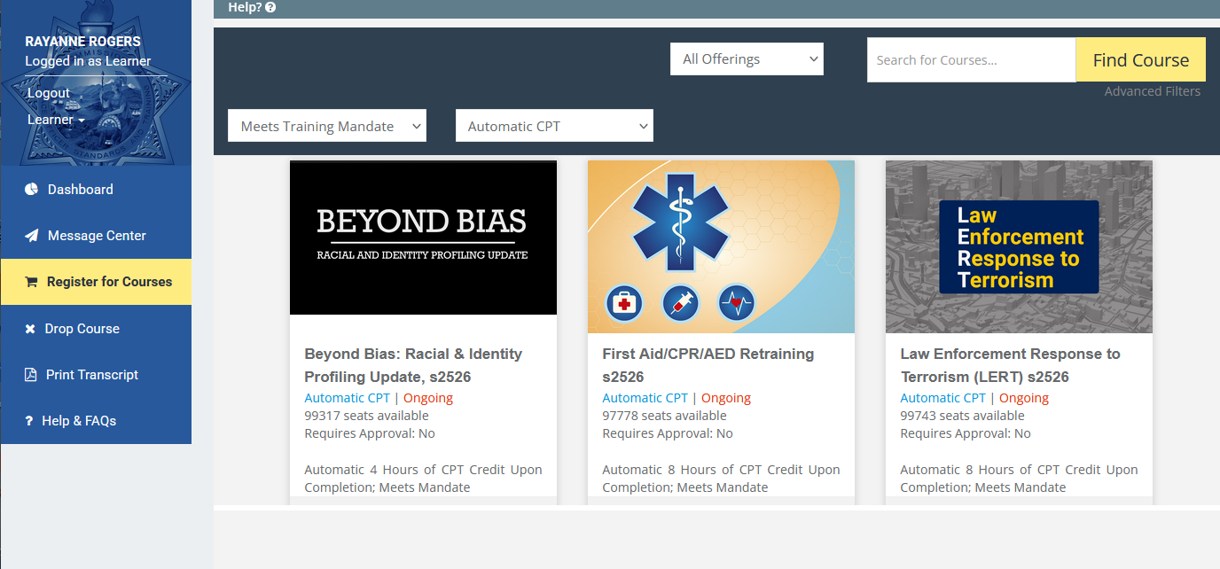
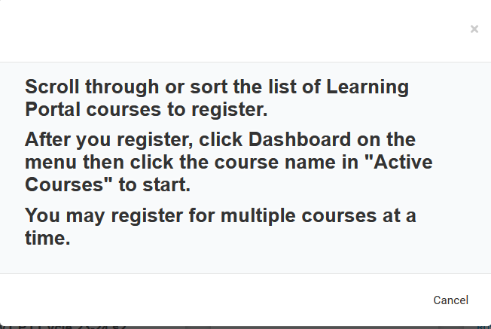
Help Feature
Notes:
See the mandate info.
Also there’s a Help Feature is available throughout the Portal. It will give you a brief description of what’s going on the page you are on.

Slide 16
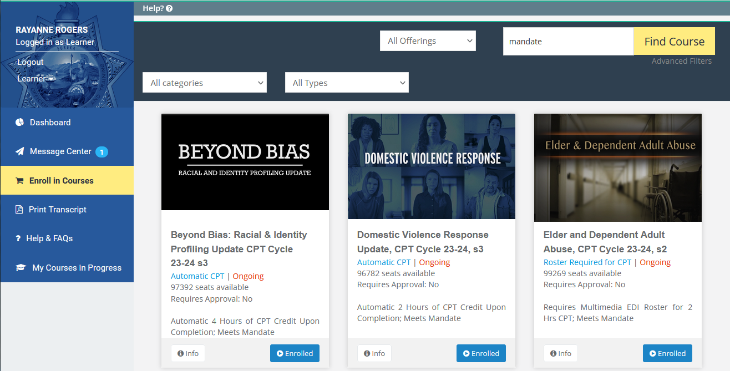
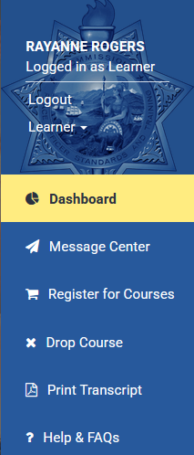

Then Click Dashboard to Start
Click Register to enroll in a course
Notes:
Let’s see how you access a course as a Learner. Your agency may have questions on this….Find the course you want. Click Register to Enroll. Enrolling puts the course on your Dashboard. Go back to the Dashboard to start a course.

Slide 17
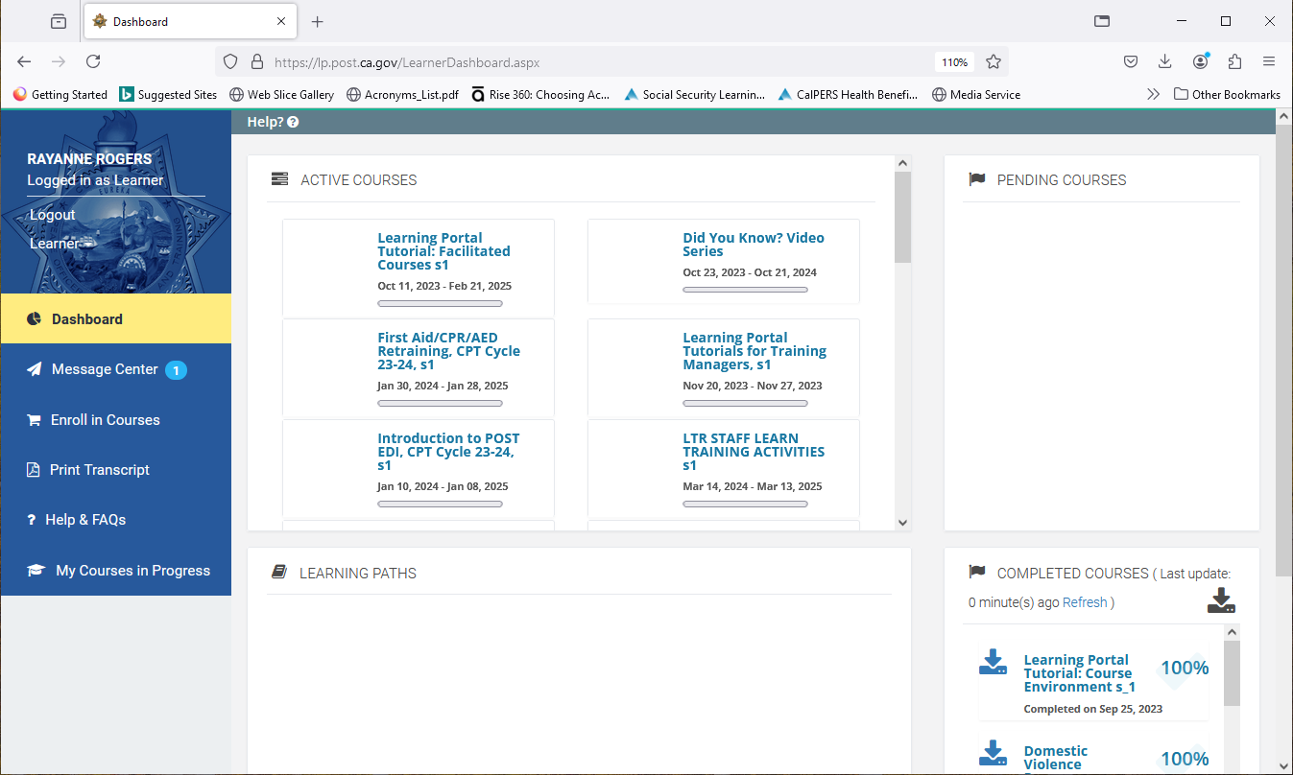
Click to Open the Training

Slide 18
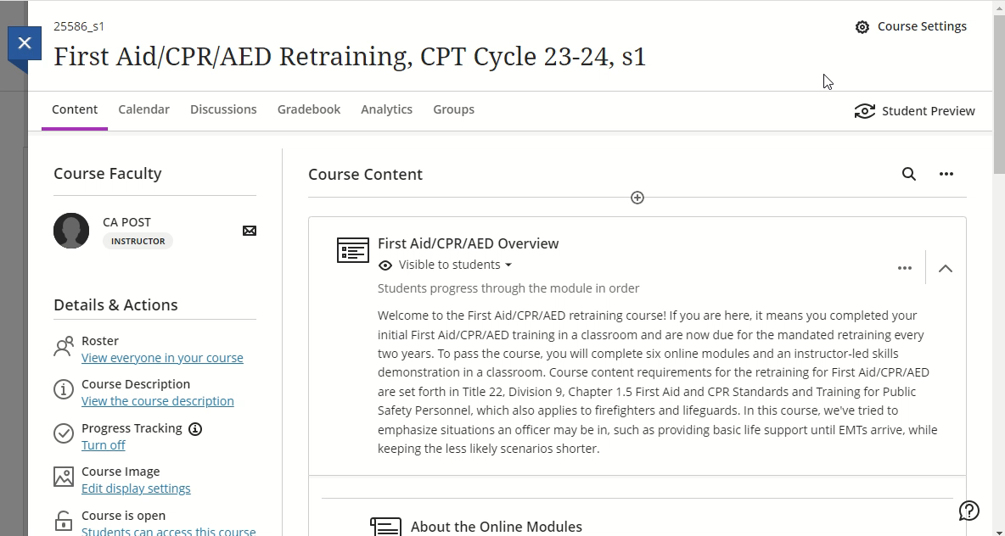
CLOSER LOOK: First Aid/CPR/AED Retraining
Notes:
Play this video for a walk through
This shows the training outline.
Complete all modules online in Portal.
Details on the online modules and the skills demo date entry are all written out. Take time to read through.
Once in-person skills demonstration is complete, Learner goes back to the Portal and enters date, after that they will receive the credit

Slide 19
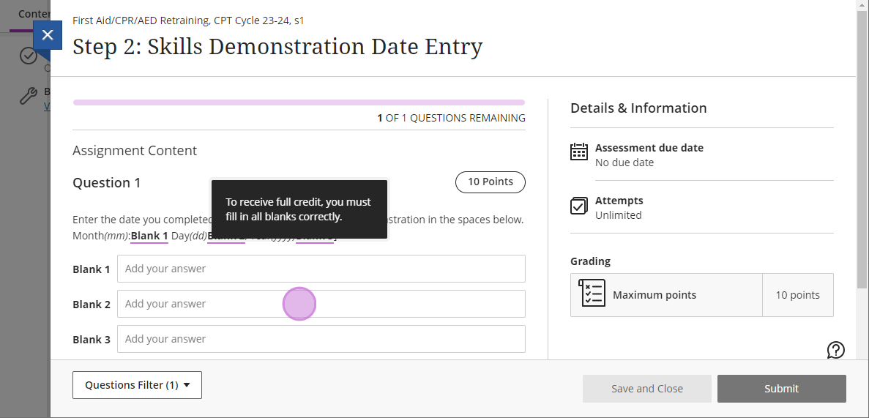
First Aid/CPR/AED Retraining
Month = mm
Day = dd
Year = yyyy
Notes:
Once in-person skills demonstration is complete, Learner goes back to the Portal and enters date, after that they will receive credit

Slide 20
Drop a Course

Slide 21
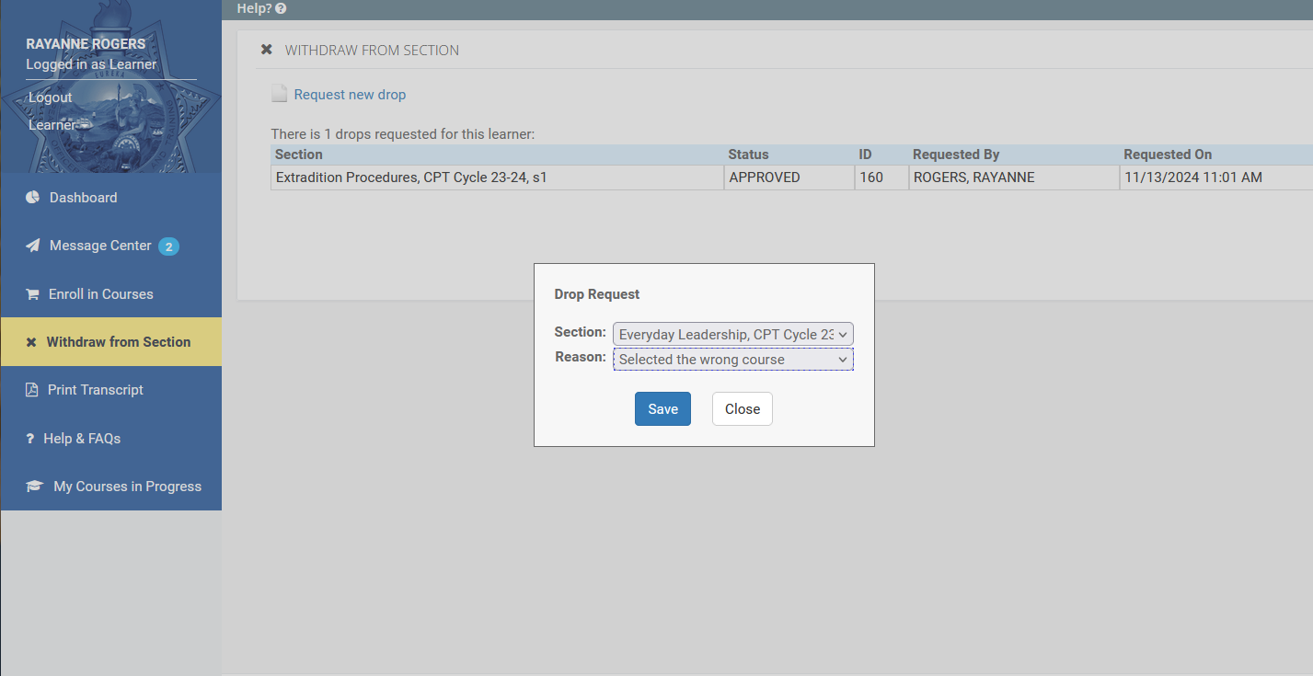
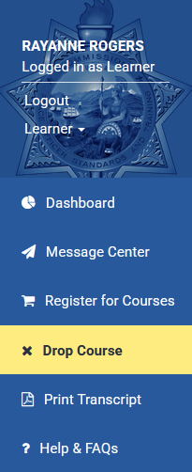
Request new drop
Find the Title, select the Reason,
Click Save
Drop Course
Notes:
You can also Drop a Course you are no longer interested in or aren’t going to complete to remove it from your Dashboard.

Slide 22
Training Manager Administrator Tools
  How?
  Fill out Form 2-339 (POST Website/Forms)
  Switch roles under your name
  Gives you a new dashboard view
  What?
  Manage Learner Lists
  Assign Training, Run Reports
  Monitor Completions and Transcripts
  Add Non-Peace Officers, if necessary
  What else?
Course Customization – Vehicle Pursuit Policy
Facilitated Courses with Training Materials
  EDI Roster Entry for Multimedia Courses

Slide 23
Activity
Training Manager View
Notes:
Now on to your LP Admin/Manager role details.
How do you know you have the Manager (Admin) role in the Portal?
Check under name Learner and Manager should be listed as your two roles. If you don’t have the Manager role and need it, go to Form 2-339 on POST Website. We will review this.

Slide 24
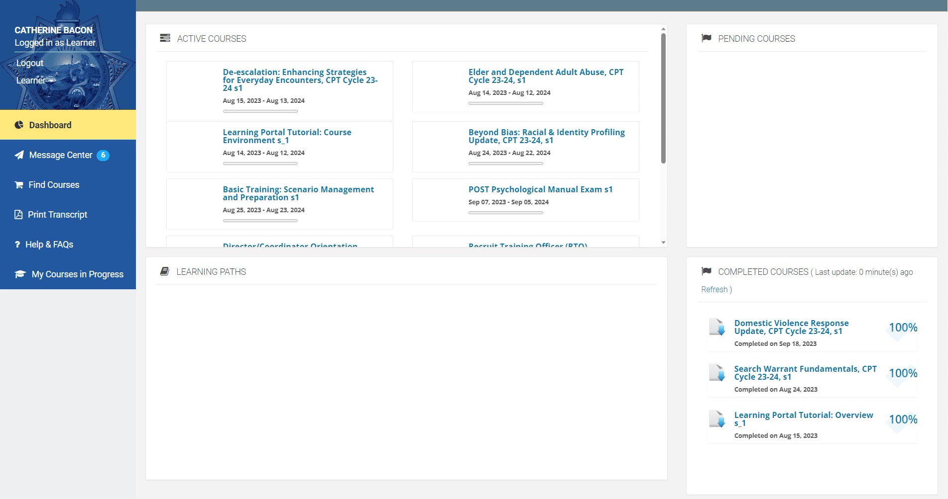
Notes:
Play this video for a walk through
To change to your Manager role…
Click under your name and change from Learner to Manager.
You now see a dashboard, a high-level look of Portal activity and accounts, for your agency
To go back as a Learner, go the right side and click Learner under your name
Then go back to Manager from the left Learner drop down
This is how you go back and forth.

Slide 25

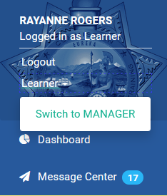
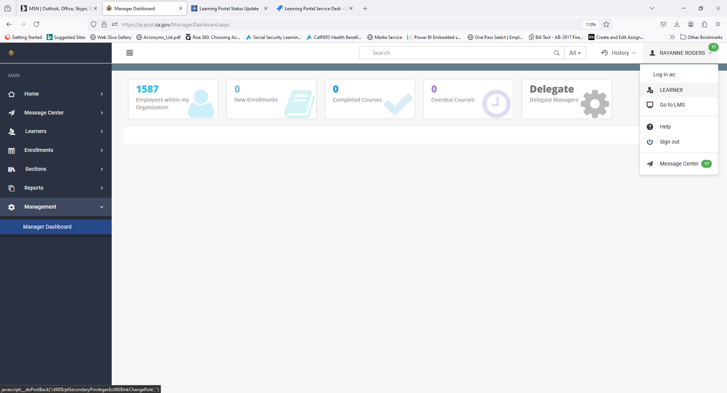
WRITTEN STEPS: Change from Learner to Manager
1.
On the left side, click under your name and click Switch to Manager (if you don’t see that, follow the link below to gain Manager/LP Admin access)
You see information for your agency
To go back as a Learner, go the right side and click Learner under your name
We’ll go back to the Manager role.
3.
Notes:
Here are the written-out steps. May skip in session.

Slide 26
Activity
Lookup Learners

Slide 27
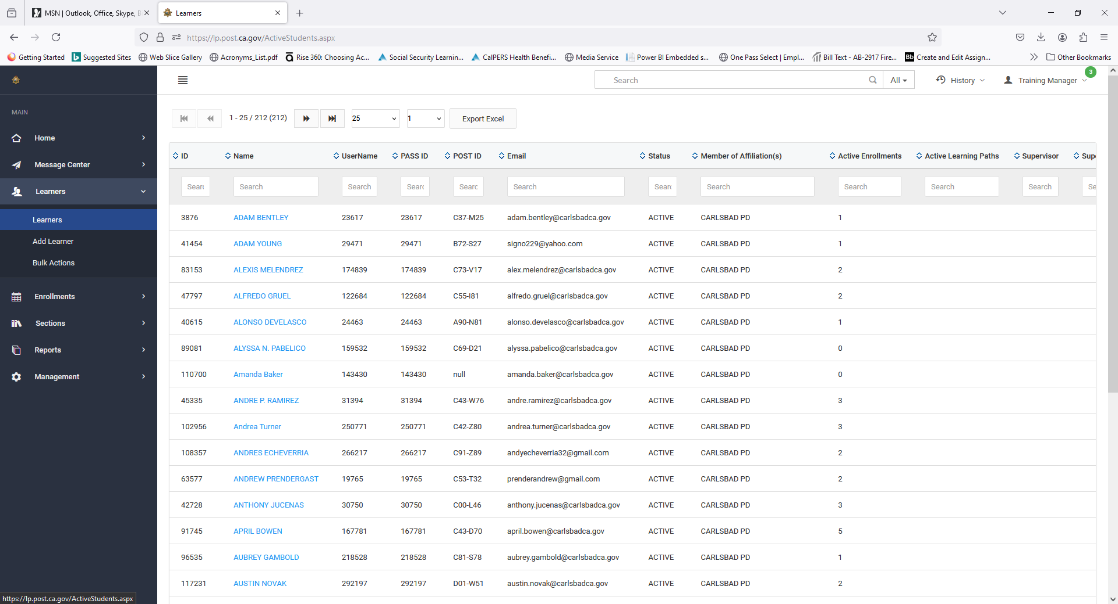
STEPS: To Search Learners
1. Click Learners
“Learners” shows your agency’s accounts in the Portal
  Enter name, POST ID, or email, etc in the search columns
Click on a Learner to see details on activities, enrollments, etc
2. Click on Name of Person
Notes:
Step by step
Learners shows your agency accounts in the Portal. Enter a name, or POST ID or email, etc in the search columns. Click on the Learner to see details on activities, enrollments, etc

Slide 28
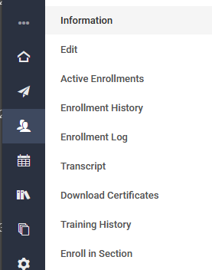
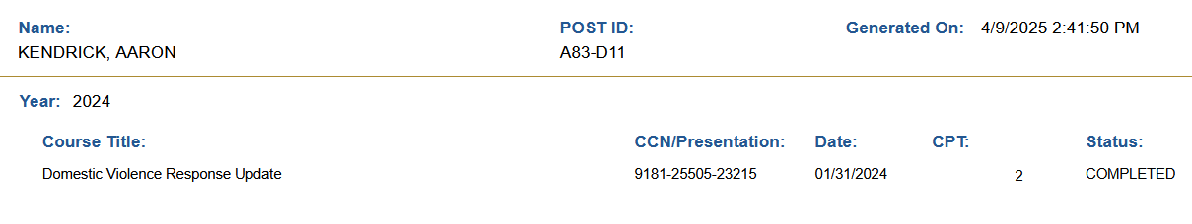
3. Enrollment History or Transcript
These are helpful areas…
  Enrollment History show a summary of courses. Can export to excel.
  Downloadable Transcript shows a summary of completions.
Last, First A99-Z99
Notes:
. The transcript shows a summary of completions can download. Enrollment History show a summary of courses. Export to excel if needed

Slide 29
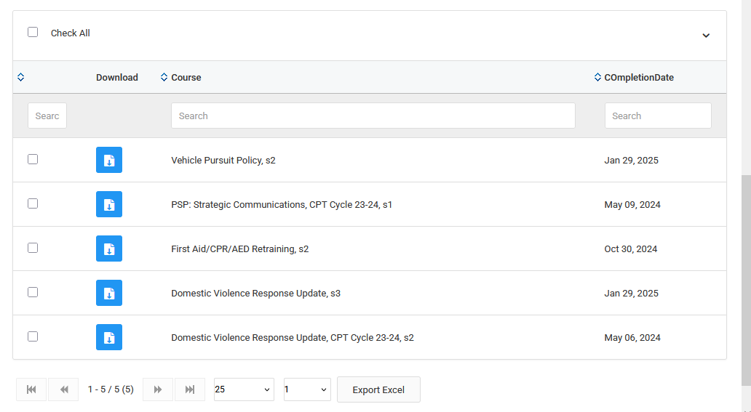
NEW feature!
  Downloadable Completion Certificates
  Scroll down and select specific Course titles
4. Download Certificates
5. Click the Blue Download button
Notes:
. The transcript shows a summary of completions can download. Enrollment History show a summary of courses. Export to excel if needed

Slide 30
Non-Peace Officers

Slide 31
Who qualifies as a Non-Peace Officer?
  A person who is…
  An employee or volunteer of your agency (clearance checked)
  Employed as an instructor at your agency such as for AICP, RBC, or SBIC
  No EDI records kept. No CPT.
  You are responsible for their activity in the Portal.
  
  
Notes:
Who qualifies as a Non-Peace Officer? And can be added to the LP by you as TM/LP Admin?
If the person is…
An employee or volunteer of your agency (clearance checked)
Employed as an instructor at your agency such as for AICP, RBC, or SBIC
No EDI records kept. No CPT. For NPOs
You are responsible for their activity in the Portal.

Slide 32
Yes or No?
Who can you add as a Non-Peace Officer…
…A person who has a Notice of Appointment (NOA) or is awaiting the NOA processing in EDI?​
  No. Have them login to the Portal follow the instructions to create a PASS account or update their password.
  …A person who is a Dispatcher at your agency?
  No. Have them login to the Portal follow the instructions to create a PASS account or update their password.
  Why?
  EDI is the system of record for all profiles and data. The Portal checks with EDI and allows or doesn’t allow dependent on the NOA status.
  
  
Notes:
Who can you add?
…A person who has a Notice of Appointment (NOA) or is awaiting the NOA processing in EDI?​
No. Have them login to the Portal follow the instructions to create a PASS account or update their password.
…A person is a Dispatcher at your agency?
No. Have them login to the Portal follow the instructions to create a PASS account or update their password.
Why?
EDI is the system of record for all profiles and data. The Portal checks with EDI and allows or doesn’t allow dependent on the NOA status.

Slide 33
Yes or No?
Who can you add as a Non-Peace Officer…
  …A person who has retired from LE and is not currently sworn but is employed by your agency in an NPO capacity?
  Yes. You may add them as an NPO.
  …A private presenter?
  No. You may not add them as an NPO.
  …Proctors?
  No. You may not add them as an NPO. Contact the BTB or SCR Bureaus at POST.
  
  
  

Slide 34
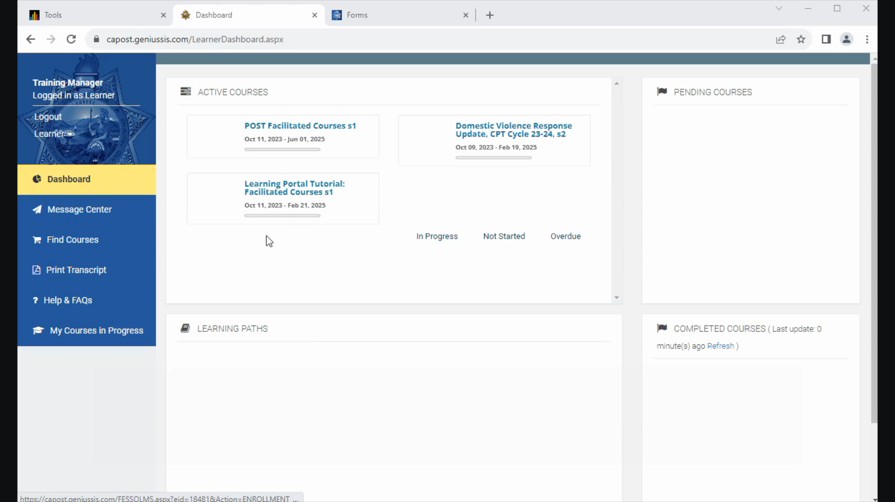
Notes:
Play this video for a walk through
How to add Non-Peace Officers from your Manager role.
Go to Learners, Add Learner
Enter the required fields in blue and the Affiliation
Leave PASS ID field blank. POST ID will automatically update when user logs in.
Mark the NPO as Yes. Account expiration is set for 2 years from date.
In the future, you can renew or end the NPO’s access changing the date
More details on managing NPOs will be in a future tutorial

Slide 35
STEPS: Add Non-Peace Officers
Go to Learners, Click Add Learner
Enter the required fields in blue and the Affiliation (your agency)
Leave PASS ID field blank
Enter 0 for the POST ID.
  It will automatically update when the NPO user logs in.
Mark the NPO as Yes.
  Account expiration is set for 2 years from date.
In the future, you can renew or end the NPO’s access by changing the date
Notes:
For training session. Show on screen the steps to take. These are hidden because they are optional to show.
Let’s do a walk through up to the point you submit the learner information.

Slide 36
Activity
Organize the Learner List
Notes:
A common question is how to remove past employees from my list of users in the Portal.
Keep in mind POST and EDI are the system of record for all training for CA LE. The Portal has another level of that so you want to be careful when making changes. If a person’s record who is retired for example won’t trigger the updated NOAT from EDI unless they login…which likely won’t do if they are retired.
Also, once a person has moved from your agency to another, and their status changes, you will no longer have access to their record. A CPRA via POST is the only way to gain access to those records after the fact.
Note: It’s the agency’s responsibility to report changes in appointment in EDI. If the Portal, does not show the more updated info from EDI, you can organize your list slightly to help your view. If you need help with any other items, let support know and they will help you.

Slide 37
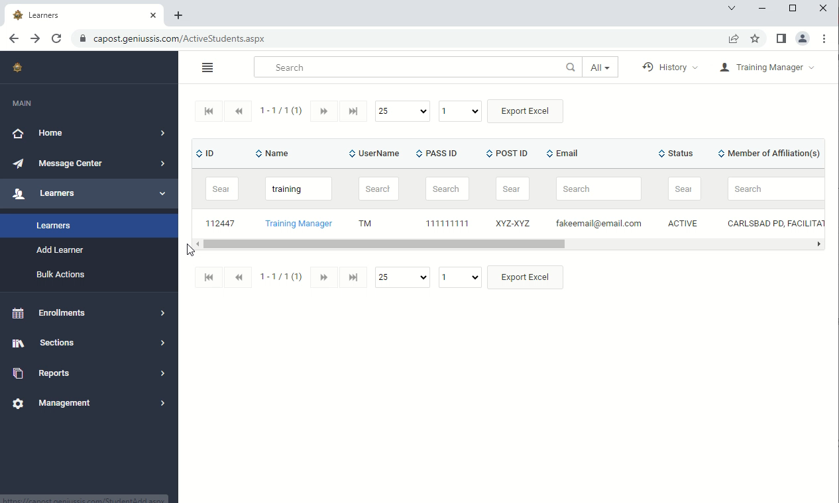
Notes:
Play this video for a walk through
(For this demo the changes were not made but only pointed out.)
With warning to make changes carefully…to clean up your Learner list you can:
Check if the Learner has multiple affiliations.
If yes, click edit and remove your affiliation by clicking the X, Save.
If no, then under Status, click Archived, Save.
Then they will be at the end of your Learner list. Under Status on the Learner page you enter Active and only see the Active people. You will need to do that each time you look at your list. We are looking at way to organize this better for you.
But you can clean up your Portal list of Learners. Don’t archive unless you know for sure they aren’t with another agency.

Slide 38
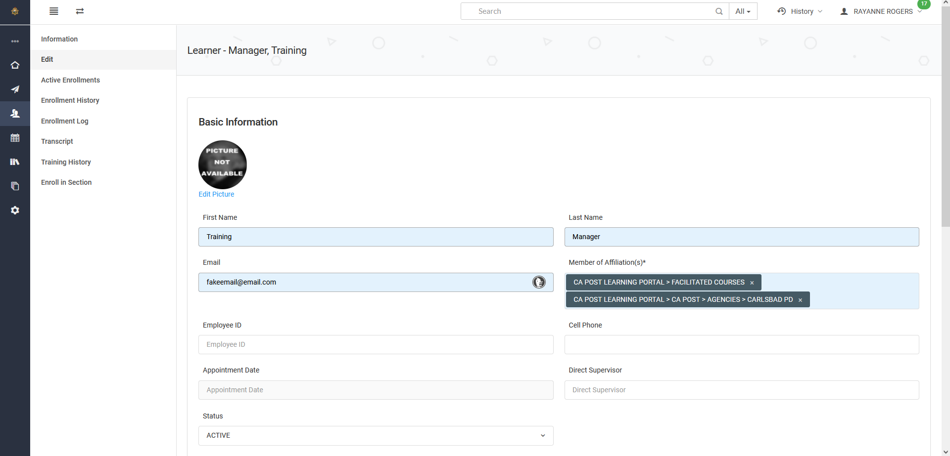
Organize Your Learners List
2. Click Edit
2. If multiple Affiliations, click the X to remove your Affiliation, which removes them from your list
1. Click Learners

Slide 39
Organize Your Learners List
3. Or if they don’t have multiple Affiliations and you know they are no longer part of your Agency, change status from Active to Archived
Just Be Sure!
Notes:
Just be sure you know this person won’t be coming back. Once you archive them and if they try to gain access again, they will be locked out of the Portal.

Slide 40
Activity
Assign/Enroll Individuals and Groups in Training

Slide 41
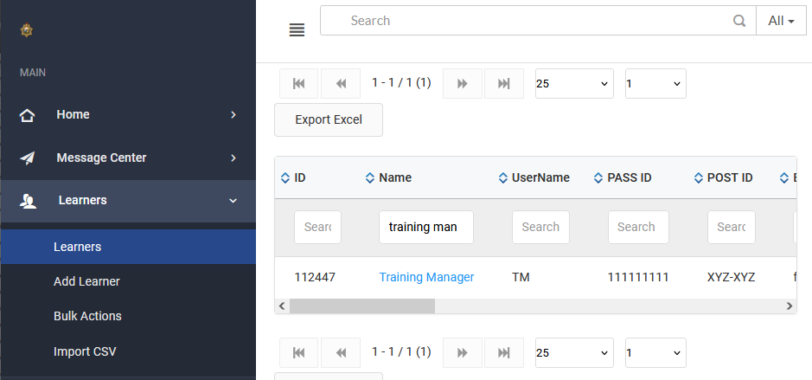
STEPS: Assign/Enroll Individuals
From Learners, find the person to assign training to
Click on the Learner’s name
Notes:
For training session. Show on screen the steps to take. These are hidden because they are optional to show.
A green confirmation message will appear. Or a red error message if you need to correct an area.
Once enrolled the person will receive an email and a message in the Portal’s Message Center.
You can keep assigning training to the individual here.

Slide 42
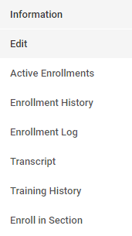
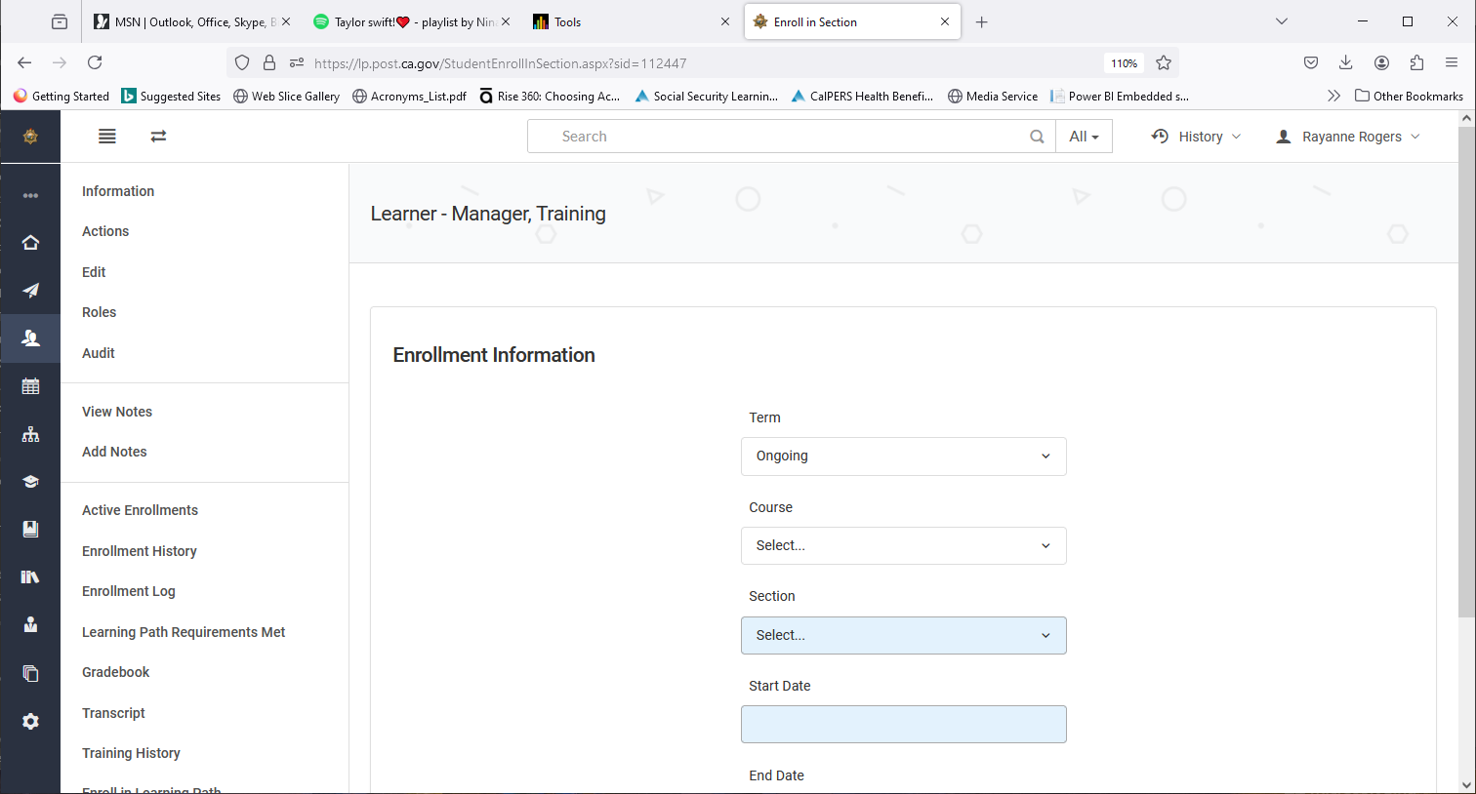
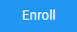
STEPS: Assign/Enroll Individuals (Con’t)
In the Learner’s details, from the left menu, click Enroll in Section
Enter the title under Course and the current Section
Enter Start and End dates
Scroll down and Click Enroll
They will be notified via email and
in the Portal’s Message Center
3. Enroll in Section
Notes:
For training session. Show on screen the steps to take. These are hidden because they are optional to show.
A green confirmation message will appear. Or a red error message if you need to correct an area.
Once enrolled the person will receive an email and a message in the Portal’s Message Center.
You can keep assigning training to the individual here.

Slide 43
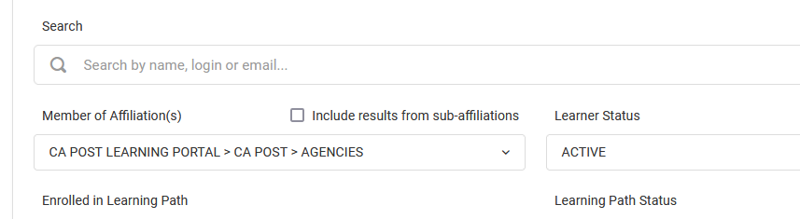
STEPS: Assign/Enroll Groups (Bulk Actions)
Under Learners, select Bulk Actions
From the Search Criteria, Select your Affiliation
Under Learner Status, click Active to help filter
Notes:
For training session. Show on screen the steps to take. These are hidden because they are optional to show.
First, we’ll pull up the list of learners. Use the search filters.
Member of Affiliations should show your agency as the affiliation. Does it?
Learner Status = Active

Slide 44

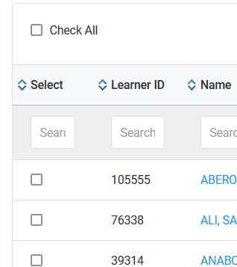
STEPS: Assign/Enroll Groups (Bulk Actions)
4. Scroll down. Click Get Data to bring up your agency
5. From that list, Check individuals or Check All
6. Scroll down and click Bulk Enroll
Notes:
For training session. Show on screen the steps to take. These are hidden because they are optional to show.
Scroll down to click Get Data
You will see a list of all your learners
Check all or find and check individual learners. Click Bulk Enroll

Slide 45
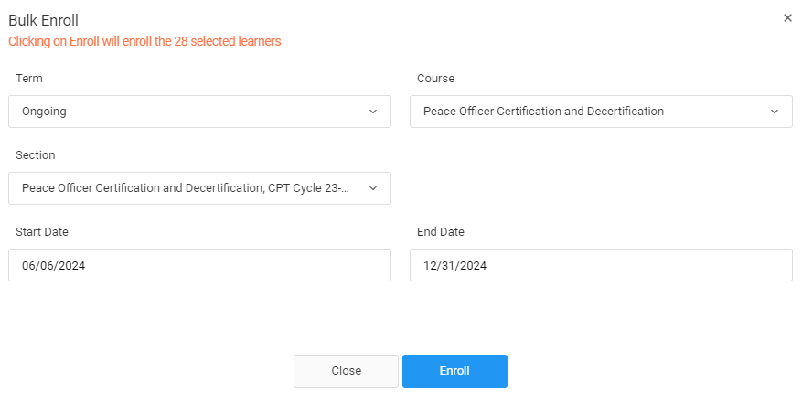
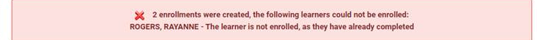
STEPS: Assign/Enroll Groups (Bulk Actions)
From the Bulk Enroll window, find the Course and Section
Select start and end dates
Click Enroll
An email will be sent telling the Learner they are enrolled
If they are already complete,
a red info message appears
Notes:
For training session. Show on screen the steps to take. These are hidden because they are optional to show.
Green confirmation will appear or a red message for corrections
You an assign multiple courses to the same group again or go back to the list of learner to select another set.

Slide 46
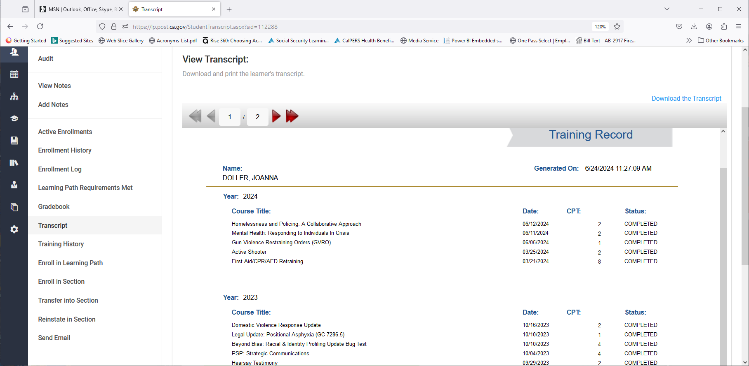
STEPS: Other Bulk Actions
“Get Transcripts PDF” button might be another valuable Bulk Action for you
Notes:
For training session. Show on screen the steps to take. These are hidden because they are optional to show.
Let’s give this a try. You can help me test.

Slide 47
Activity
Run Reports

Slide 48
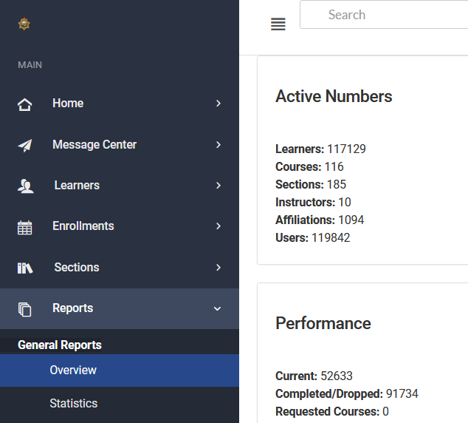
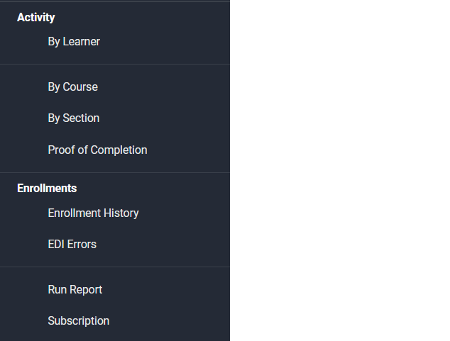
STEPS: Run Reports
From Manager Dashboard, Click Reports
Scroll down to Run Report
1. Reports
2. Run Report
Notes:
For training session. Show on screen the steps to take. These are hidden because they are optional to show.
On running an enrollment history report and opening it in excel. There are several types of reports so feel free to try different ones. In the future, we hope to have some common reports for you to run. The options here aren’t quite what we want for you, but we are working on it.

Slide 49
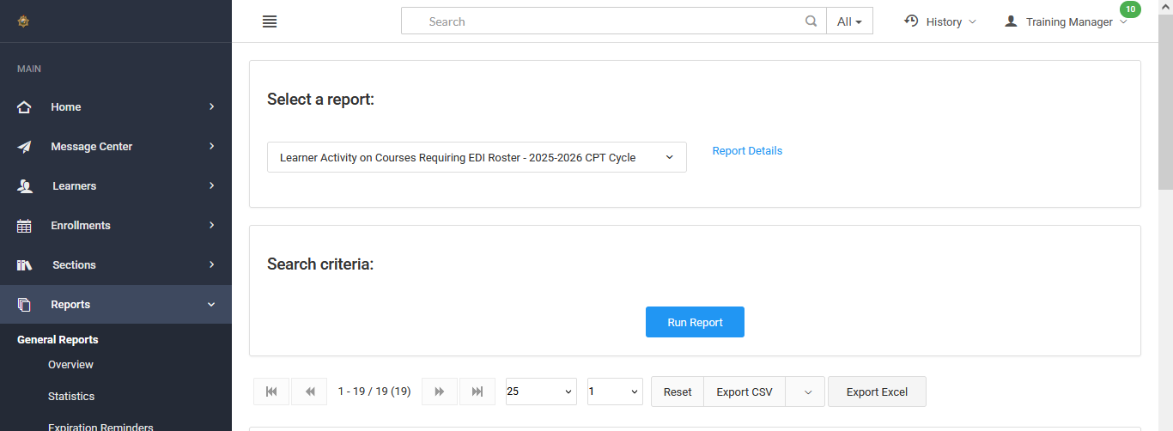
STEPS: Run Reports
3. Learner Activity Report …Requiring EDI Roster…
4. Run Report
5. Export to Excel

Slide 50
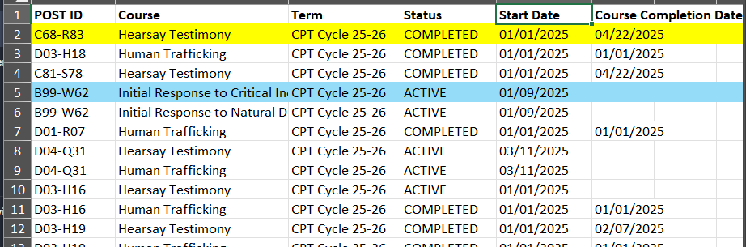
STEPS: Run Reports
Completed in Portal Needs EDI roster added
Still Enrolled / In Progress

Slide 51
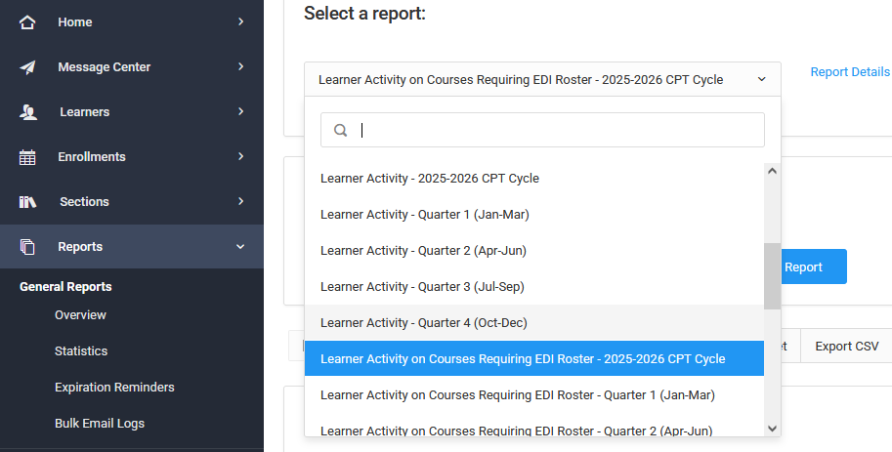
STEPS: Run Reports
Use reports with “Learner Activity” in title

Slide 52
Activity
How the Course Customization
(VPP) Works

Slide 53
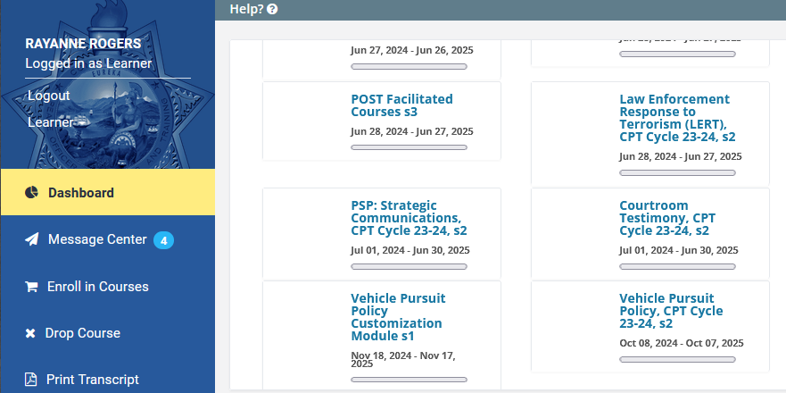
Overview of VPP Customization Module
Select Vehicle
Pursuit Policy
Customization Module
Notes:
If you are a LP Admin with Manager access you have been assigned the VPP CM, go to your Dashboard to locate the VPP and open the CM. Have a copy of your agency’s pursuit policy in PDF form ready.

Slide 54
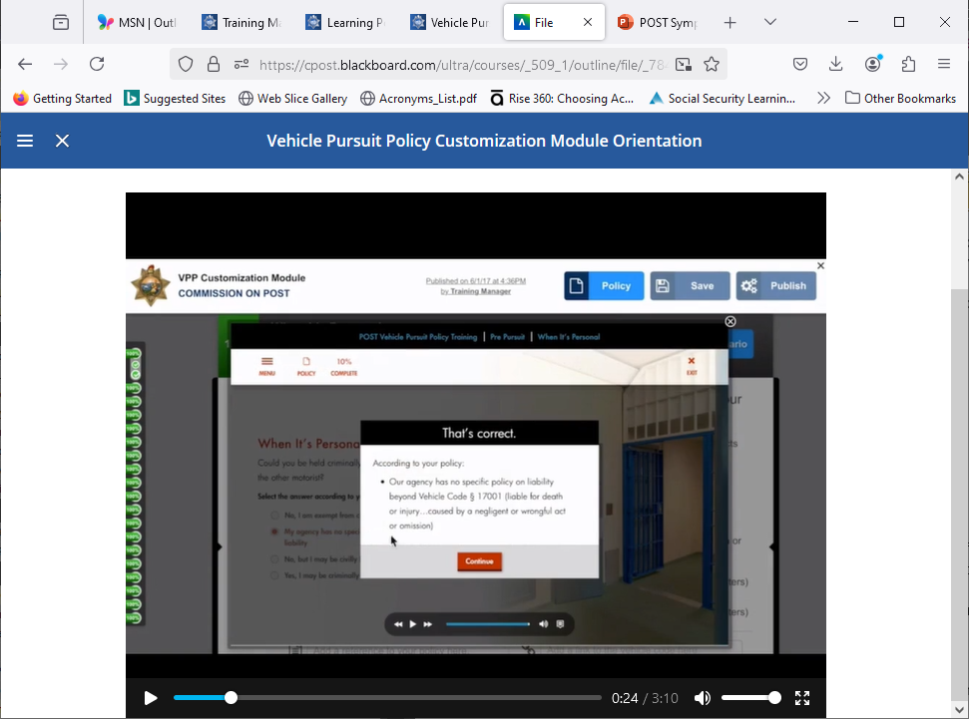
Vehicle Pursuit Policy Customization Module and Course Info
Annual mandate for Vehicle Pursuit Policy training (PC 13519.8)
Customization module is automatically assigned LP Admins
LP Admins customize to match agency’s policy
TMs receive an enrollment email with a link
TMs need to:
  Log in and review the 3-minute
  orientation
  Open the customization module
  Upload a PDF version of policy, even it was
  uploaded before
  Review your customizations for accuracy
  Your progress will be saved
  Publish your customizations
Notes:
A few more details to explain…
Annual mandate for Vehicle Pursuit Policy training (PC13519.8)
Training managers with Learning Portal Administrator access can customize the course to match their agency’s policy
Customization module is automatically assigned Learning Portal Administrators
TMs received an enrollment email with a link
TMs will need to:
Log in and review the CM info and 3-minute orientation
Open the customization module.
Customizations in place prior to 6/16/2023 have been
restored
If new to the CM, they can start the questionnaire
Upload a PDF version of your agency policy even if you had
an uploaded file before
Review and preview your customizations for accuracy. You can
leave and return to the customization module. Your progress
will be saved.
Publish your customizations. The course will be available for
registration in the catalog; however, learners will not be able
to start the course until the customizations are published.

Slide 55
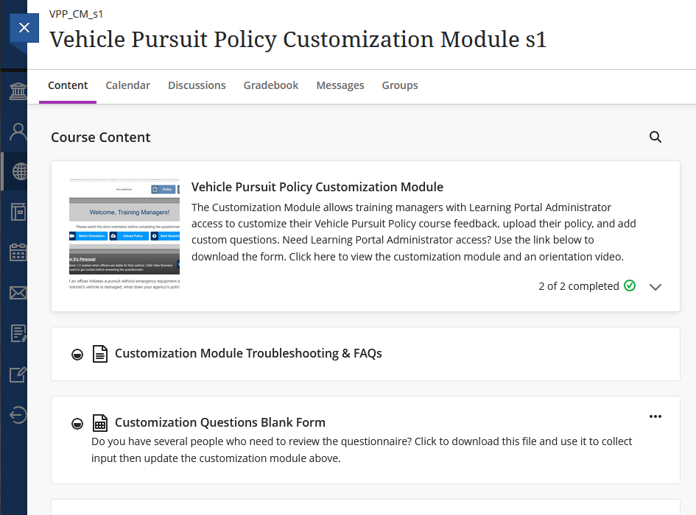
Overview of VPP Customization Module
Read through the FAQs and resources
Notes:
Scroll and read through each of these sections such as the FAQs and Guidelines

Slide 56
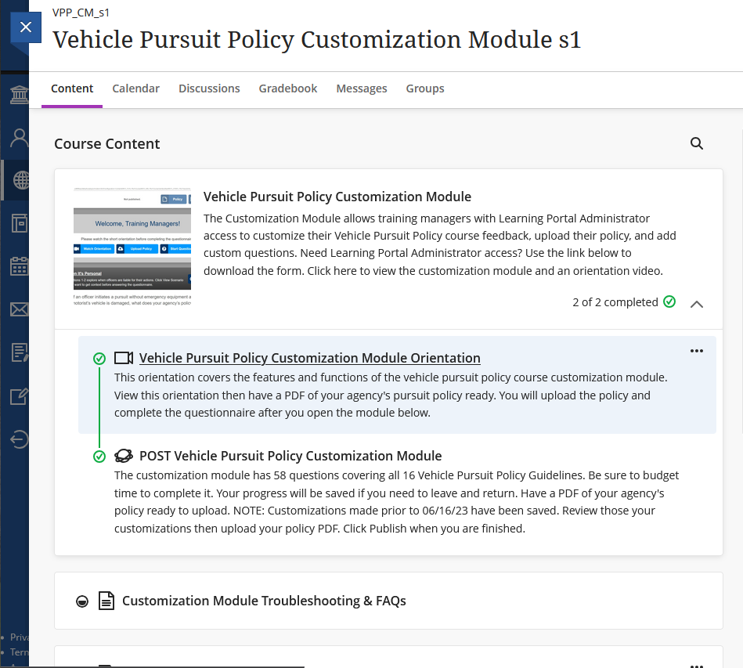

Overview of VPP Customization Module
Open the first block
Watch the 3-minute orientation
Start the customization
Notes:
Open the first block and select the Orientation video
Have a PDF (under 30 MB) of your vehicle pursuit policy, upload your policy even it was uploaded before, then start the customization steps

Slide 57

Notes:
VPP Orientation. Click to play.

Slide 58
Activity
POST Facilitated Courses and Guides

Slide 59



POST Facilitated Courses
Find POST Facilitated Courses
Click Facilitated Courses Explained
Notes:
Changed this process just a bit recently.
Now this “folder” of training materials sits in your Dashboard for easier access.
Click on POST Facilitated Courses.
Scroll or search for a title.
Review the course information.
Find and download the facilitator guide.

Slide 60
POST Facilitated Courses
POST Facilitated Courses
Titles in Alpha order or use Search
Notes:
Changed this process just a bit recently.
Now this “folder” of training materials sits in your Dashboard for easier access.
Click on POST Facilitated Courses.
Scroll or search for a title.
Review the course information.
Find and download the facilitator guide.

Slide 61



Guides
Training
Notes:
The facilitator can also download a facilitator guide and student guide. The course can be presented over several sessions if time is a factor.
This shows a sample outline of what’s covered for Active Shooter training. Click on sections and play the video and follow along with the facilitation guide.

Slide 62
POST Facilitated Courses List
To get back, click the X
Notes:
To return to the Dashboard, click the X, then…

Slide 63

POST Facilitated Courses List
Click Tools then Genius Dashboard
Notes:
Tools, then Genius Dashboard.

Slide 64
Activity
How to Give Credit in EDI when Rosters are Required
Notes:
But how do you know which courses need a roster? We can demo a new report coming to help. In the meantime, you may need to cross refence in the Portal catalog which say “Roster Required”.

Slide 65

Notes:
Click to play video.
Log into your EDI account at https://edinet.post.ca.gov/home.aspx
Under GENERAL QUICK LINKS section at left, select Course Rosters (or from the top header drop-down menus, select Courses then select Rosters.)
Select Enter Roster on Behalf of: (Select Agency/Presenter from drop-down)
Select POST MULTI-MEDIA COURSE (Cert # 29000)
Select the Presentation Title (you can sort titles A-to-Z by clicking at the top of the column)
Follow prompts to complete the Course Roster

Slide 66
Entering POST Facilitated Training Videos (Multimedia) Course Rosters into EDI
Written Instructions
https://post.ca.gov/portals/0/post_docs/training/TrainingVideoCourseRosters_Instructions.pdf
Log into your EDI account at https://edinet.post.ca.gov/home.aspx
Under GENERAL QUICK LINKS section at left, select Course Rosters (or from the top header drop-down menus, select Courses then select Rosters.)
Select Enter Roster on Behalf of: (Select Agency/Presenter from drop-down)
Select POST MULTI-MEDIA COURSE (Cert # 29000)
Select the Presentation Title (you can sort titles A-to-Z by clicking at the top of the column)
Follow prompts to complete the Course Roster
Notes:
The instructions from the link on how to enter an EDI roster for the Hybrid/Facilitated course topics.

Slide 67
Let’s Review
How do you switch between your Learner and Manager views?
How do you enroll/assign training?
How do you run a report of course completions?
Where do you find information on how to enter a roster in EDI for the facilitated video courses, so Learners get CPT credit?
Notes:
Take 5 minutes to answers these questions

Slide 68
Review
How do you switch between your Learner and Manager views?
After log in, from the left panel, click the arrow next to “Learner” and switch to “Manager.” As a Manager, click the dropdown menu on the right and select Learner.

Slide 69
Review
How do you enroll/assign training?
Individual: Find the learner, click Enroll in Section, select the course and section, set the start and end dates (if needed), and enroll.
Group: Go to Bulk Actions, get the list of learners, select the learners to assign, click Bulk Enroll, then select the course and section and set the start and end dates (if needed), and enroll.
Notes:
Several places

Slide 70
Review
How do you run reports?
Go to Reports > Run Report.
Select a report that starts with “Learner Activity”.
Click Run Report button and Export to Excel.
Notes:
Several places

Slide 71
Review
How do you enter a roster in EDI for the facilitated video courses, so Learners get CPT credit?
In POST Facilitated Courses, see the Facilitated Courses Explained tutorial.
Or go to: https://post.ca.gov/portals/0/post_docs/training/TrainingVideoCourseRosters_Instructions.pdf
Notes:
Several places. Also a link on the sign-in page.

Slide 72


Stay Informed!
  Sign up to receive the Learning Portal quarterly newsletter
  Go to the POST web page (www.post.ca.gov)
  Sign in to PASS, if needed
  Open “Your PASS” account, under your name
  Click the Subscriptions Tab

Slide 73
Where to Find Help
Training Managers Page on POST Website
-- Portal Tutorials and Access Instructions
-- Plus, this PowerPoint https://post.ca.gov/training-managers
Quick Reference Guide – Download/Print
https://post.ca.gov/learning-technology-resources
Notes:
Use these links for more information
Provide details about issue when contacting support
Take some time to review the contents of the TM page. Find the Learning Portal Section

Slide 74



Where to Find Help
Contact the Support Team for Help
support@postportal.atlassian.net or 916-970-4650
Entering Rosters for Facilitated Training Videos
Entering Rosters into EDI Instructions
Learning Portal Administration/Manager
Fill out POST Website Form 2-339
Learning Portal Trainings that Meet Mandates
These Portal Trainings Meet Mandates
Notes:
Use these links for more information

