Slide 1

POST Learning Portal Overview
Portal Support Team
support@postportal.atlassian.net
916-970-4650
EDI Help
EDI@post.ca.gov
916-275-5872
California Commission on
Peace Officer Standards and Training
Notes:
PowerPoint updated October 2025
LP Help Phone: 916-970-4650
EDI Help Phone: 916-275-5872
What questions do you have before we start?
The slide deck will be available in a few days on the website.
Ready?
Press ENTER.

Slide 2
What We’ll
Cover Today
Learning Portal Basics
Products Recently Released and in Production
Hands-on Activities
Training Manager Tools
Learning Portal Help
Notes:
Today we will cover:
Press ENTER
* Learning Portal Basics
Press ENTER
* Products recently released and in production
Press ENTER
* Utilize hands-on activities
Press ENTER
* Review Training Manager tools
Press ENTER
* Learning Portal help
Press ENTER

Slide 3
POST
Learning
Portal
  What?
  Training Courses, Informational Resources, Tutorials
  Why?
  Free, 24/7 Access, Meet Mandates, Manage Learners, Assign Training, Run Reports
  Where?
  www.lp.post.ca.gov
  How?
  PASS account plus either: Sworn Staff/NOA, Dispatchers, or manually added Non-Peace Officers
Notes:
POST Learning Portal :
Press ENTER
What
Press Enter
Courses, Informational Resources, Tutorials
Press ENTER
Why
Press ENTER
Free, 24/7 Access, Meet Mandates, Manage Learners, Assign Training, Run Reports
Press ENTER
Where
Press ENTER
From POST Website or Direct URL
Press ENTER
How
Press ENTER
PASS account, Sworn Staff/NOA, Non-Peace Officers
Press ENTER
The Learning Portal is a free, secure website for California peace officers, dispatchers, and law enforcement instructors. It provides 24/7 access to many of the products developed by LTR. It’s one option for training and video resources. What are you using it for?
Distance learning including self-paced courses and training videos to be facilitated/discussed and an EDI roster to be entered. Video topics and resources are available to train with.
Did You Know? Series - provides short, informational videos that can be used for roll call training or assigned for general information. Agencies small to medium sized a huge benefit.
Many courses meet mandates, including most products meet the 24 hour every 2 years CPT credit requirement.
Tutorials and informational segments provide support and reference. Some distance learning course completions are automatically posted to the student’s POST training profile for Continuing Professional Training (CPT) credit. Details about CPT credit for each product is provided in the Learning Portal description for each topic.
Press ENTER

Slide 4
Trainings
Recently Released or
In Progress
  THIS YEAR (2025):
    Responding to Behavioral Health Conditions
    High-Technology Crimes
    Officer Safety: Critical Incidents
    First Aid/CPR/AED Replacement
    Science-Based Interviewing
    PSP: Strategic Communications Updates
  NEXT YEAR (2026):
    PL 280: Policing Indians Lands
    Anti-Reproductive Rights Crimes
    Hate Crimes: ID and Investigation
Notes:
Recently Released or In Progress
For 2025
Responding to Behavioral Health Conditions
High-Technology Crimes
Officer Safety: Critical Incidents
First Aid/CPR/AED Replacement
Science-Based Interviewing
PSP: Strategic Communications Update
Press ENTER
For 2026
PL 280: Policing Indian Lands
Anti-Reproductive Rights Crimes
Hate Crimes: ID and Investigation
Press ENTER

Slide 5
How Tos
Logging in / Sign up / POST Pass
Find, Register For, and Drop Courses
Learner and Manager Navigation
Manager Features: Assign Training, Run Reports Plus VPP, NPOs, Rosters – Need Form 2-339
Notes:
Who is a LP Admin with Manager role? If not, then submit form 2-339 to LP Support.
We will log into POST Pass
Press ENTER
Navigate learner and manager roles
Press ENTER
Find, register for, and drop courses
Press ENTER
Review manager features
Press ENTER

Slide 6
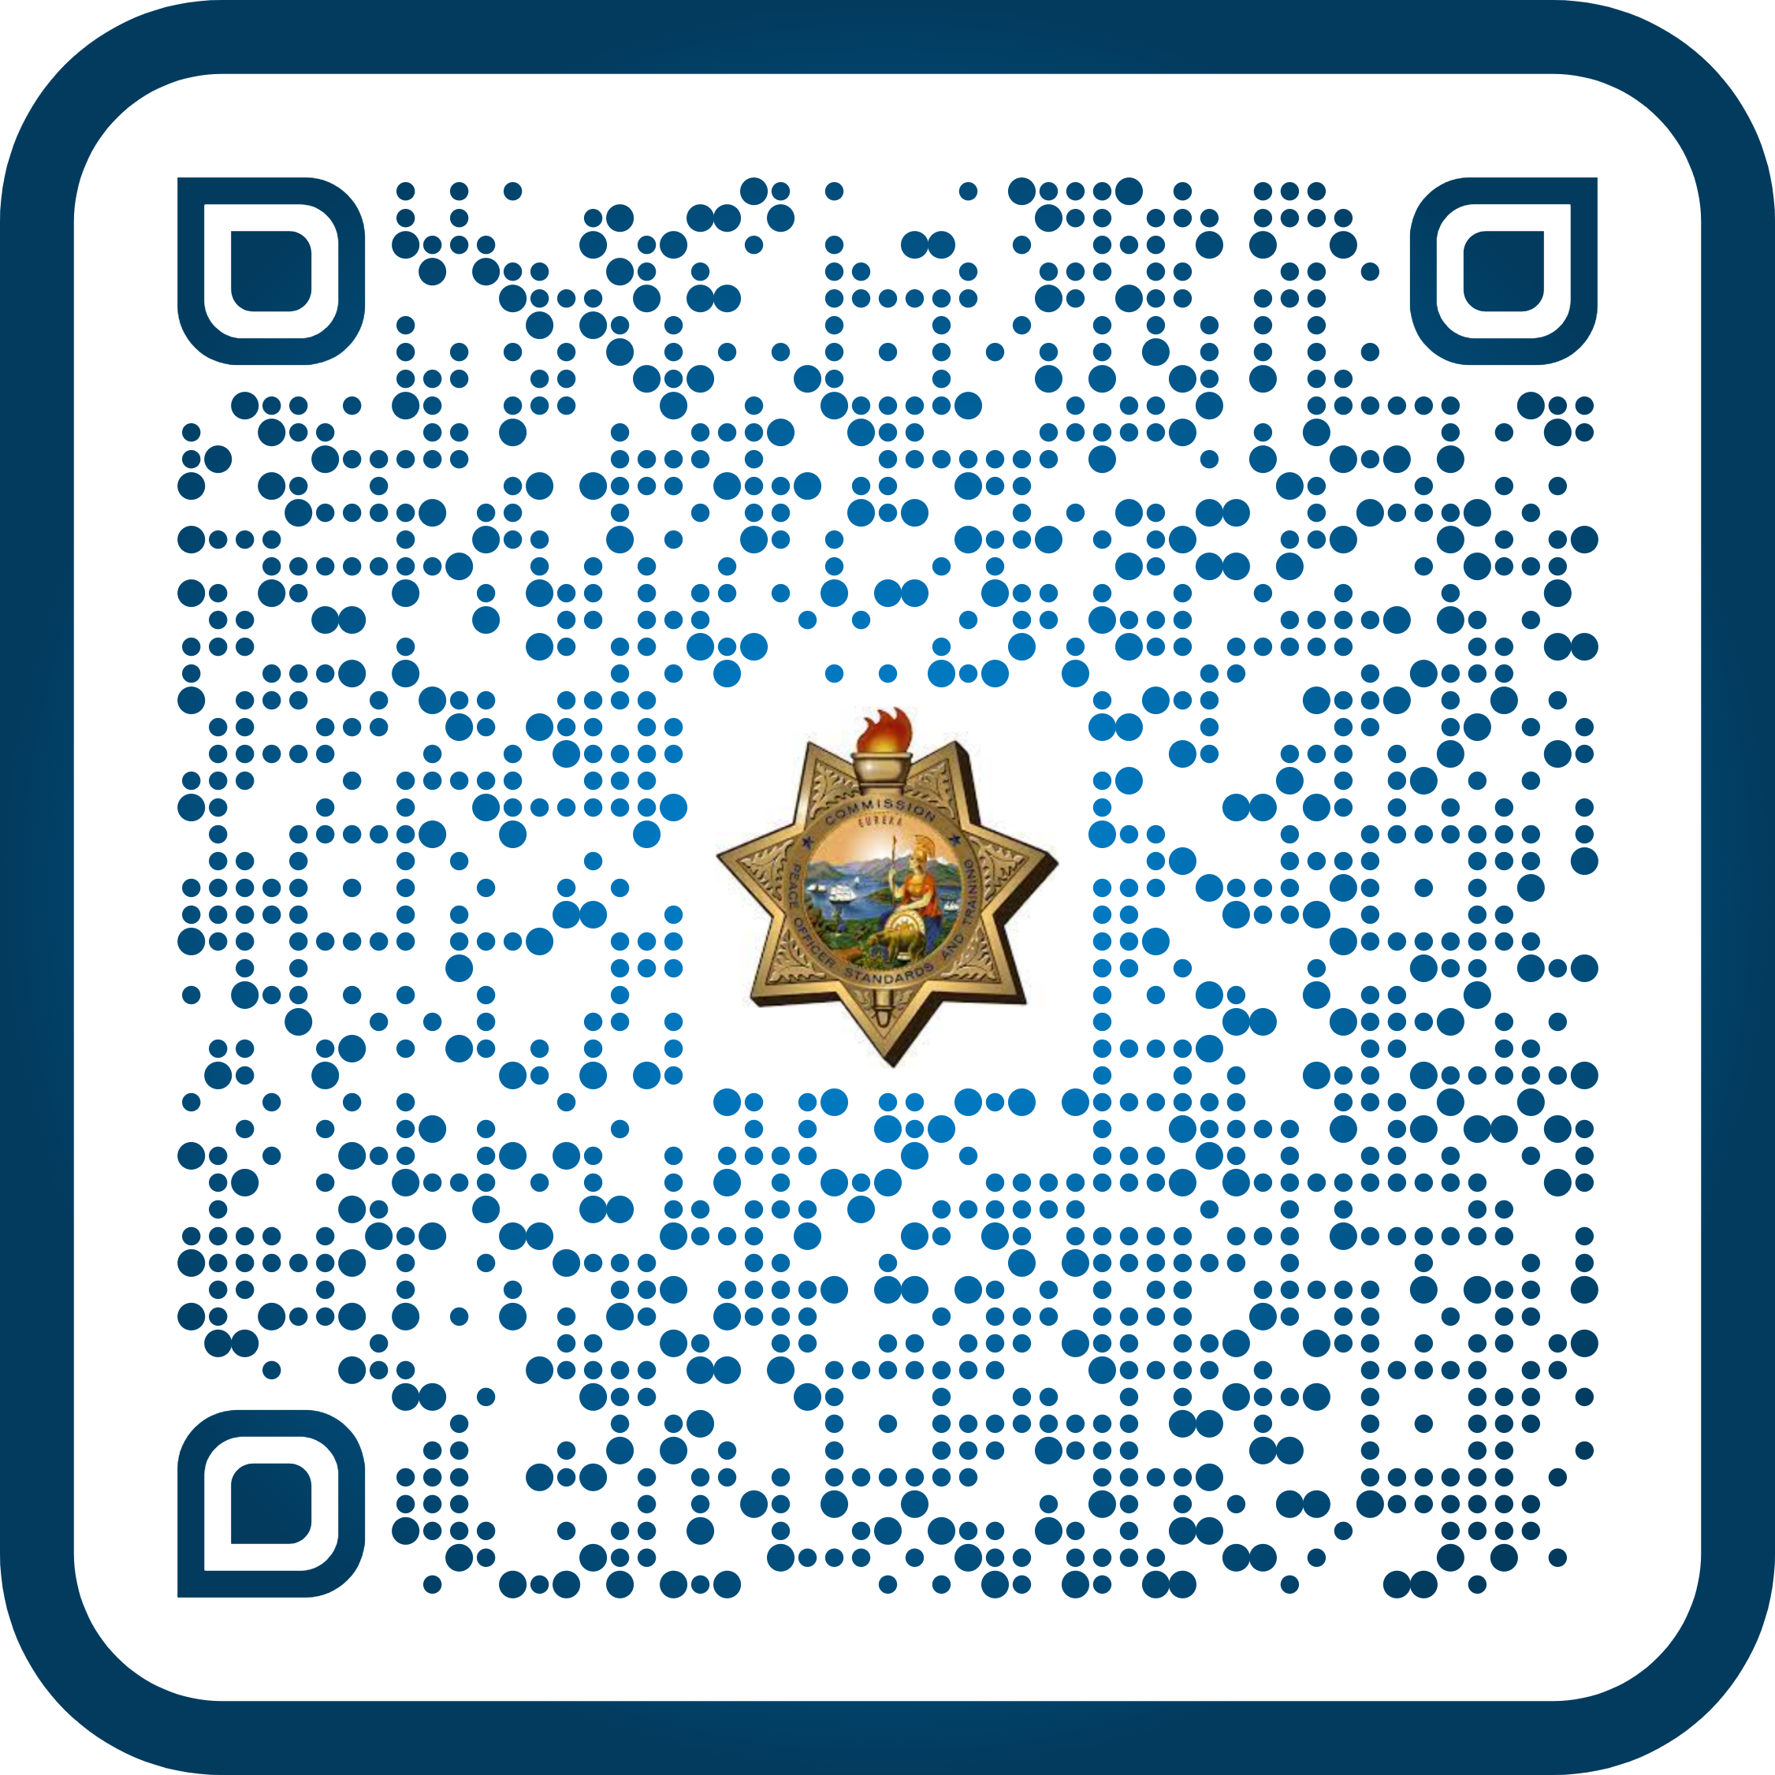
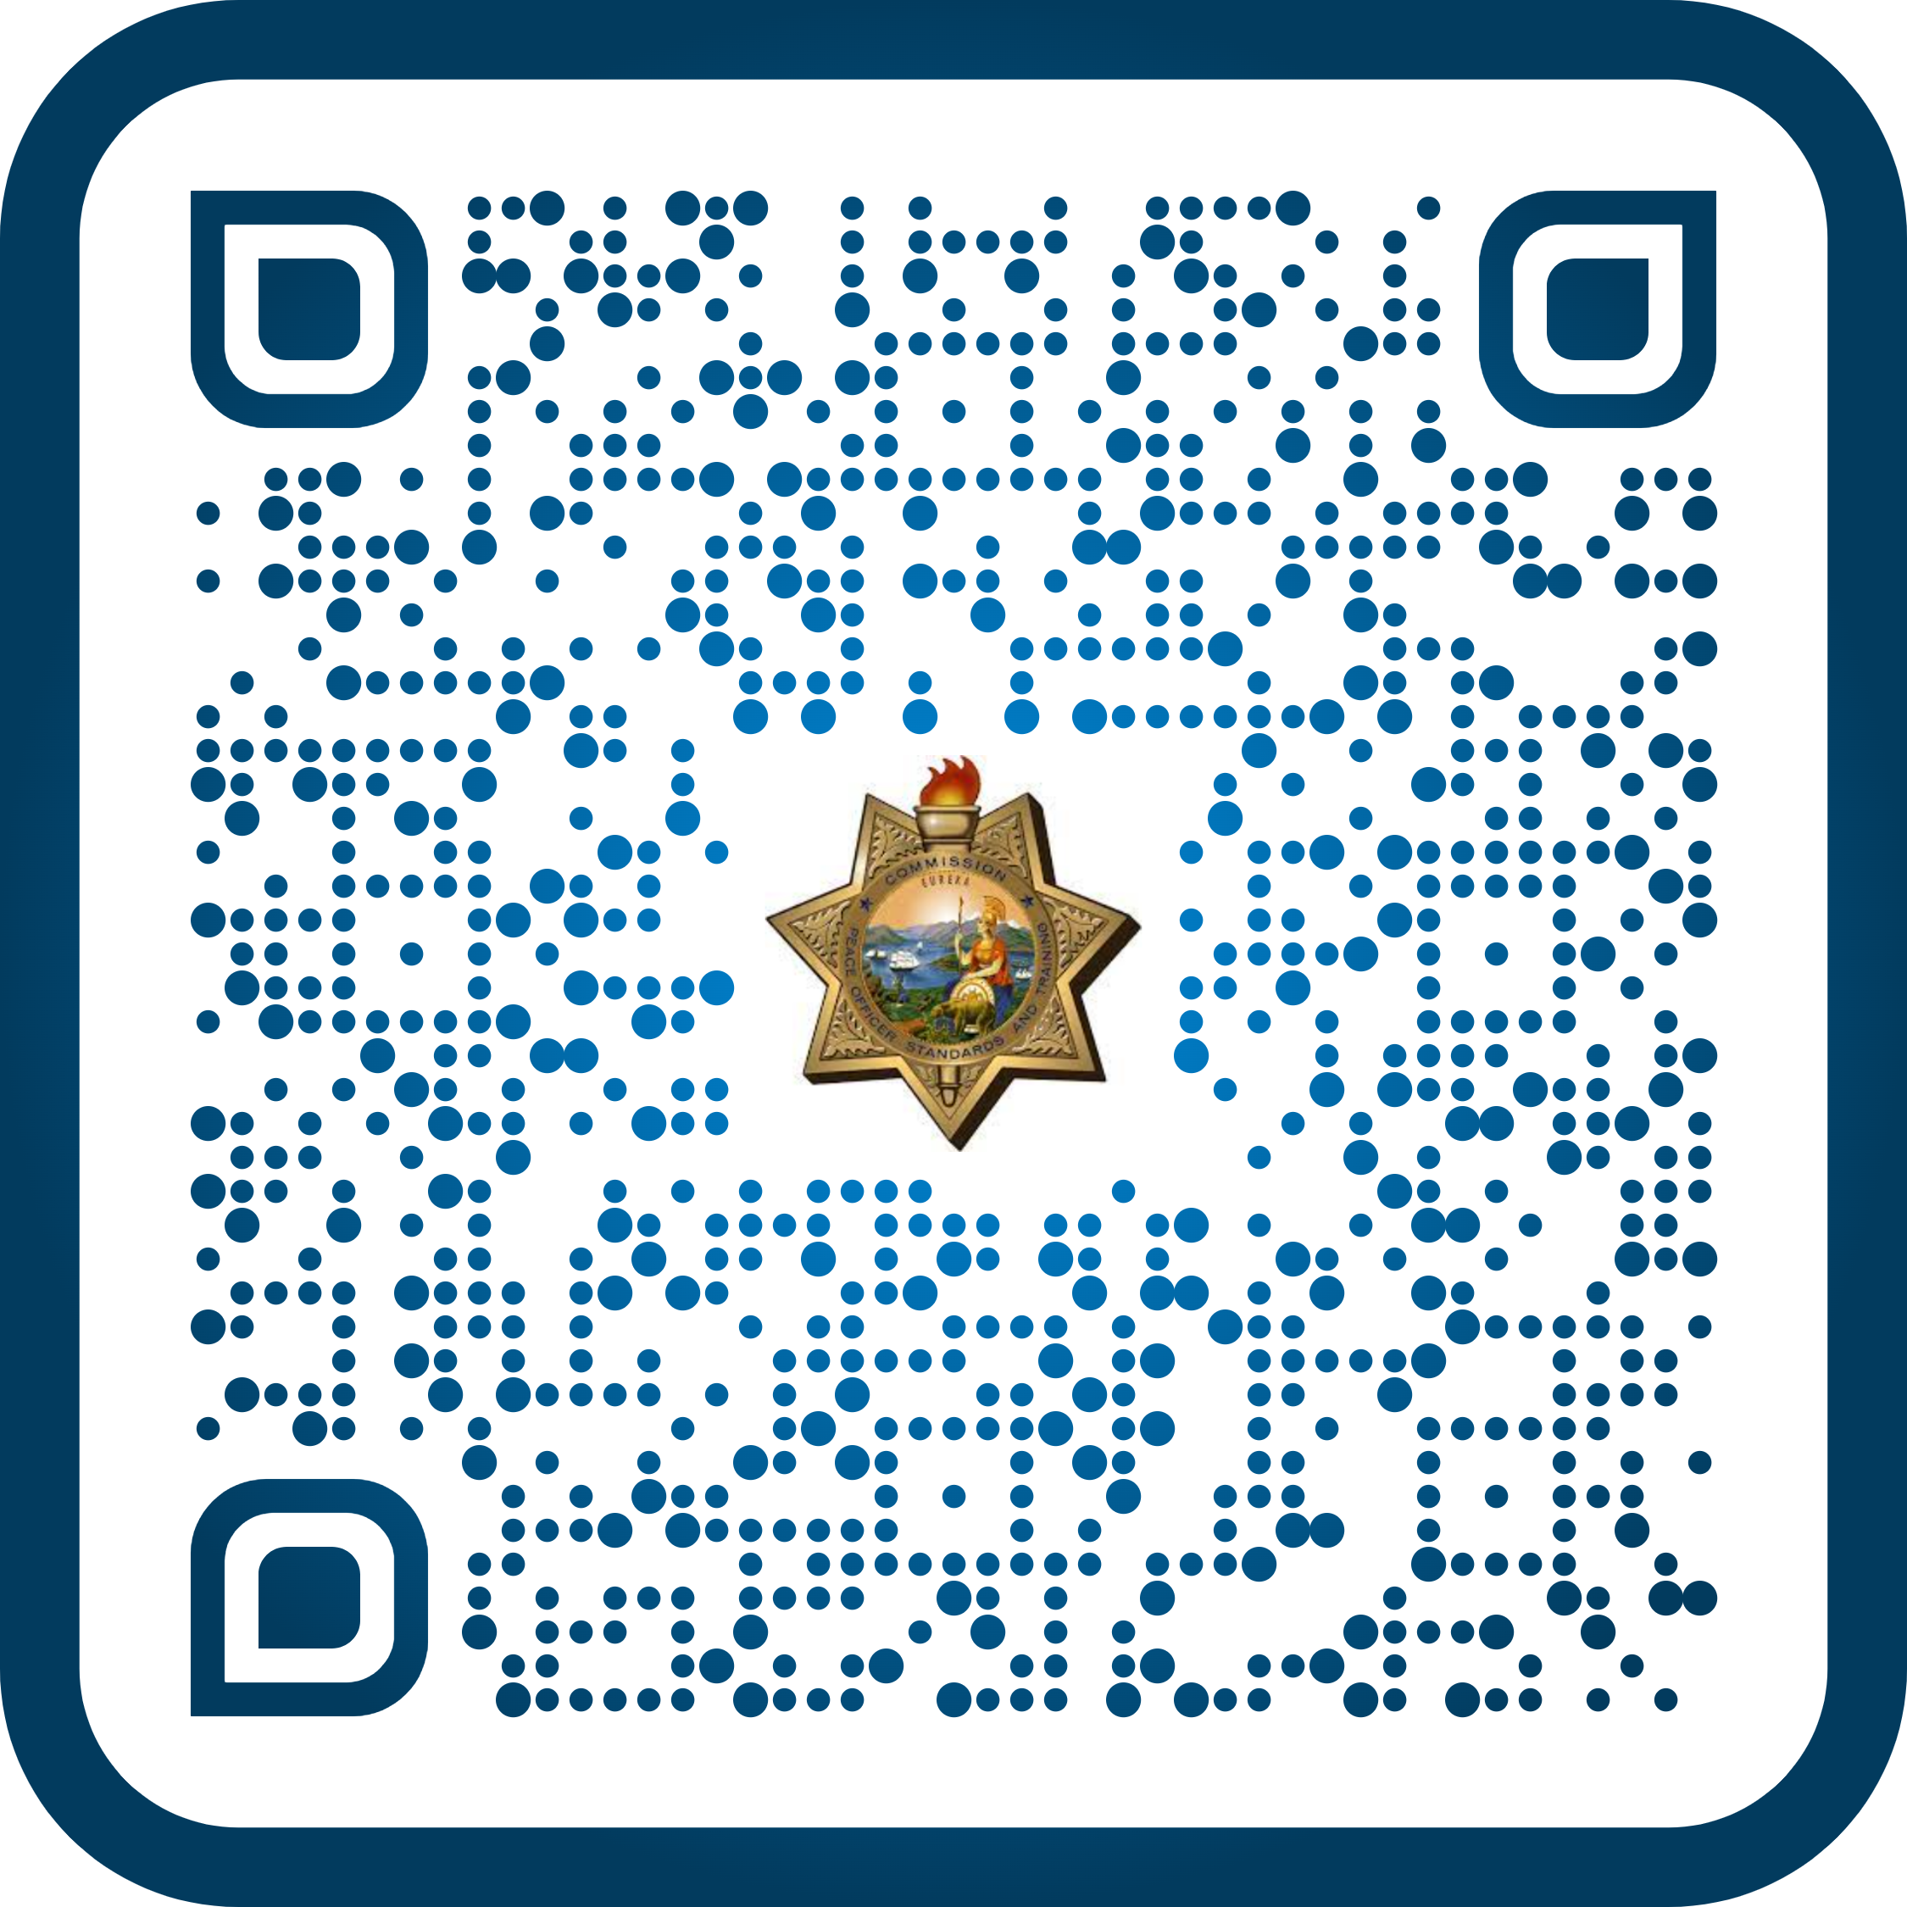
Where to Find Help
1. Support Team support@postportal.atlassian.net or 916-970-4650
2. Enter Rosters for Training Videos
Instructions on entering rosters into EDI
3. Learning Portal Administration/Manager
Fill out POST Website Form 2-339
Notes:
Use these links for more information
Press ENTER
Support Team: Feel free to email or call with specific questions. Make sure to provide as much information as possible.
Press ENTER
Enter Rosters for Training Videos: Use the link or the QR Code to find this information.
Press ENTER
Learning Portal Administration/Manager: Use the link or the QR Code to get to Form 2-339.
Press ENTER

Slide 7
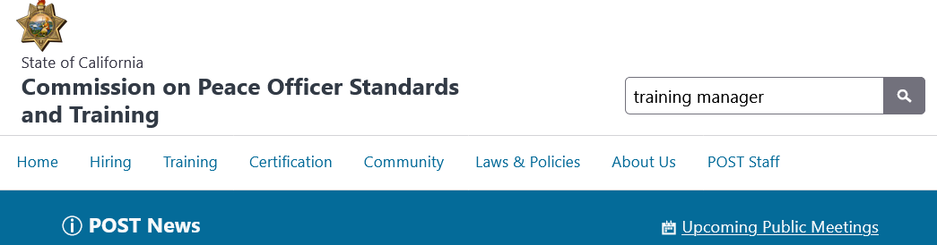
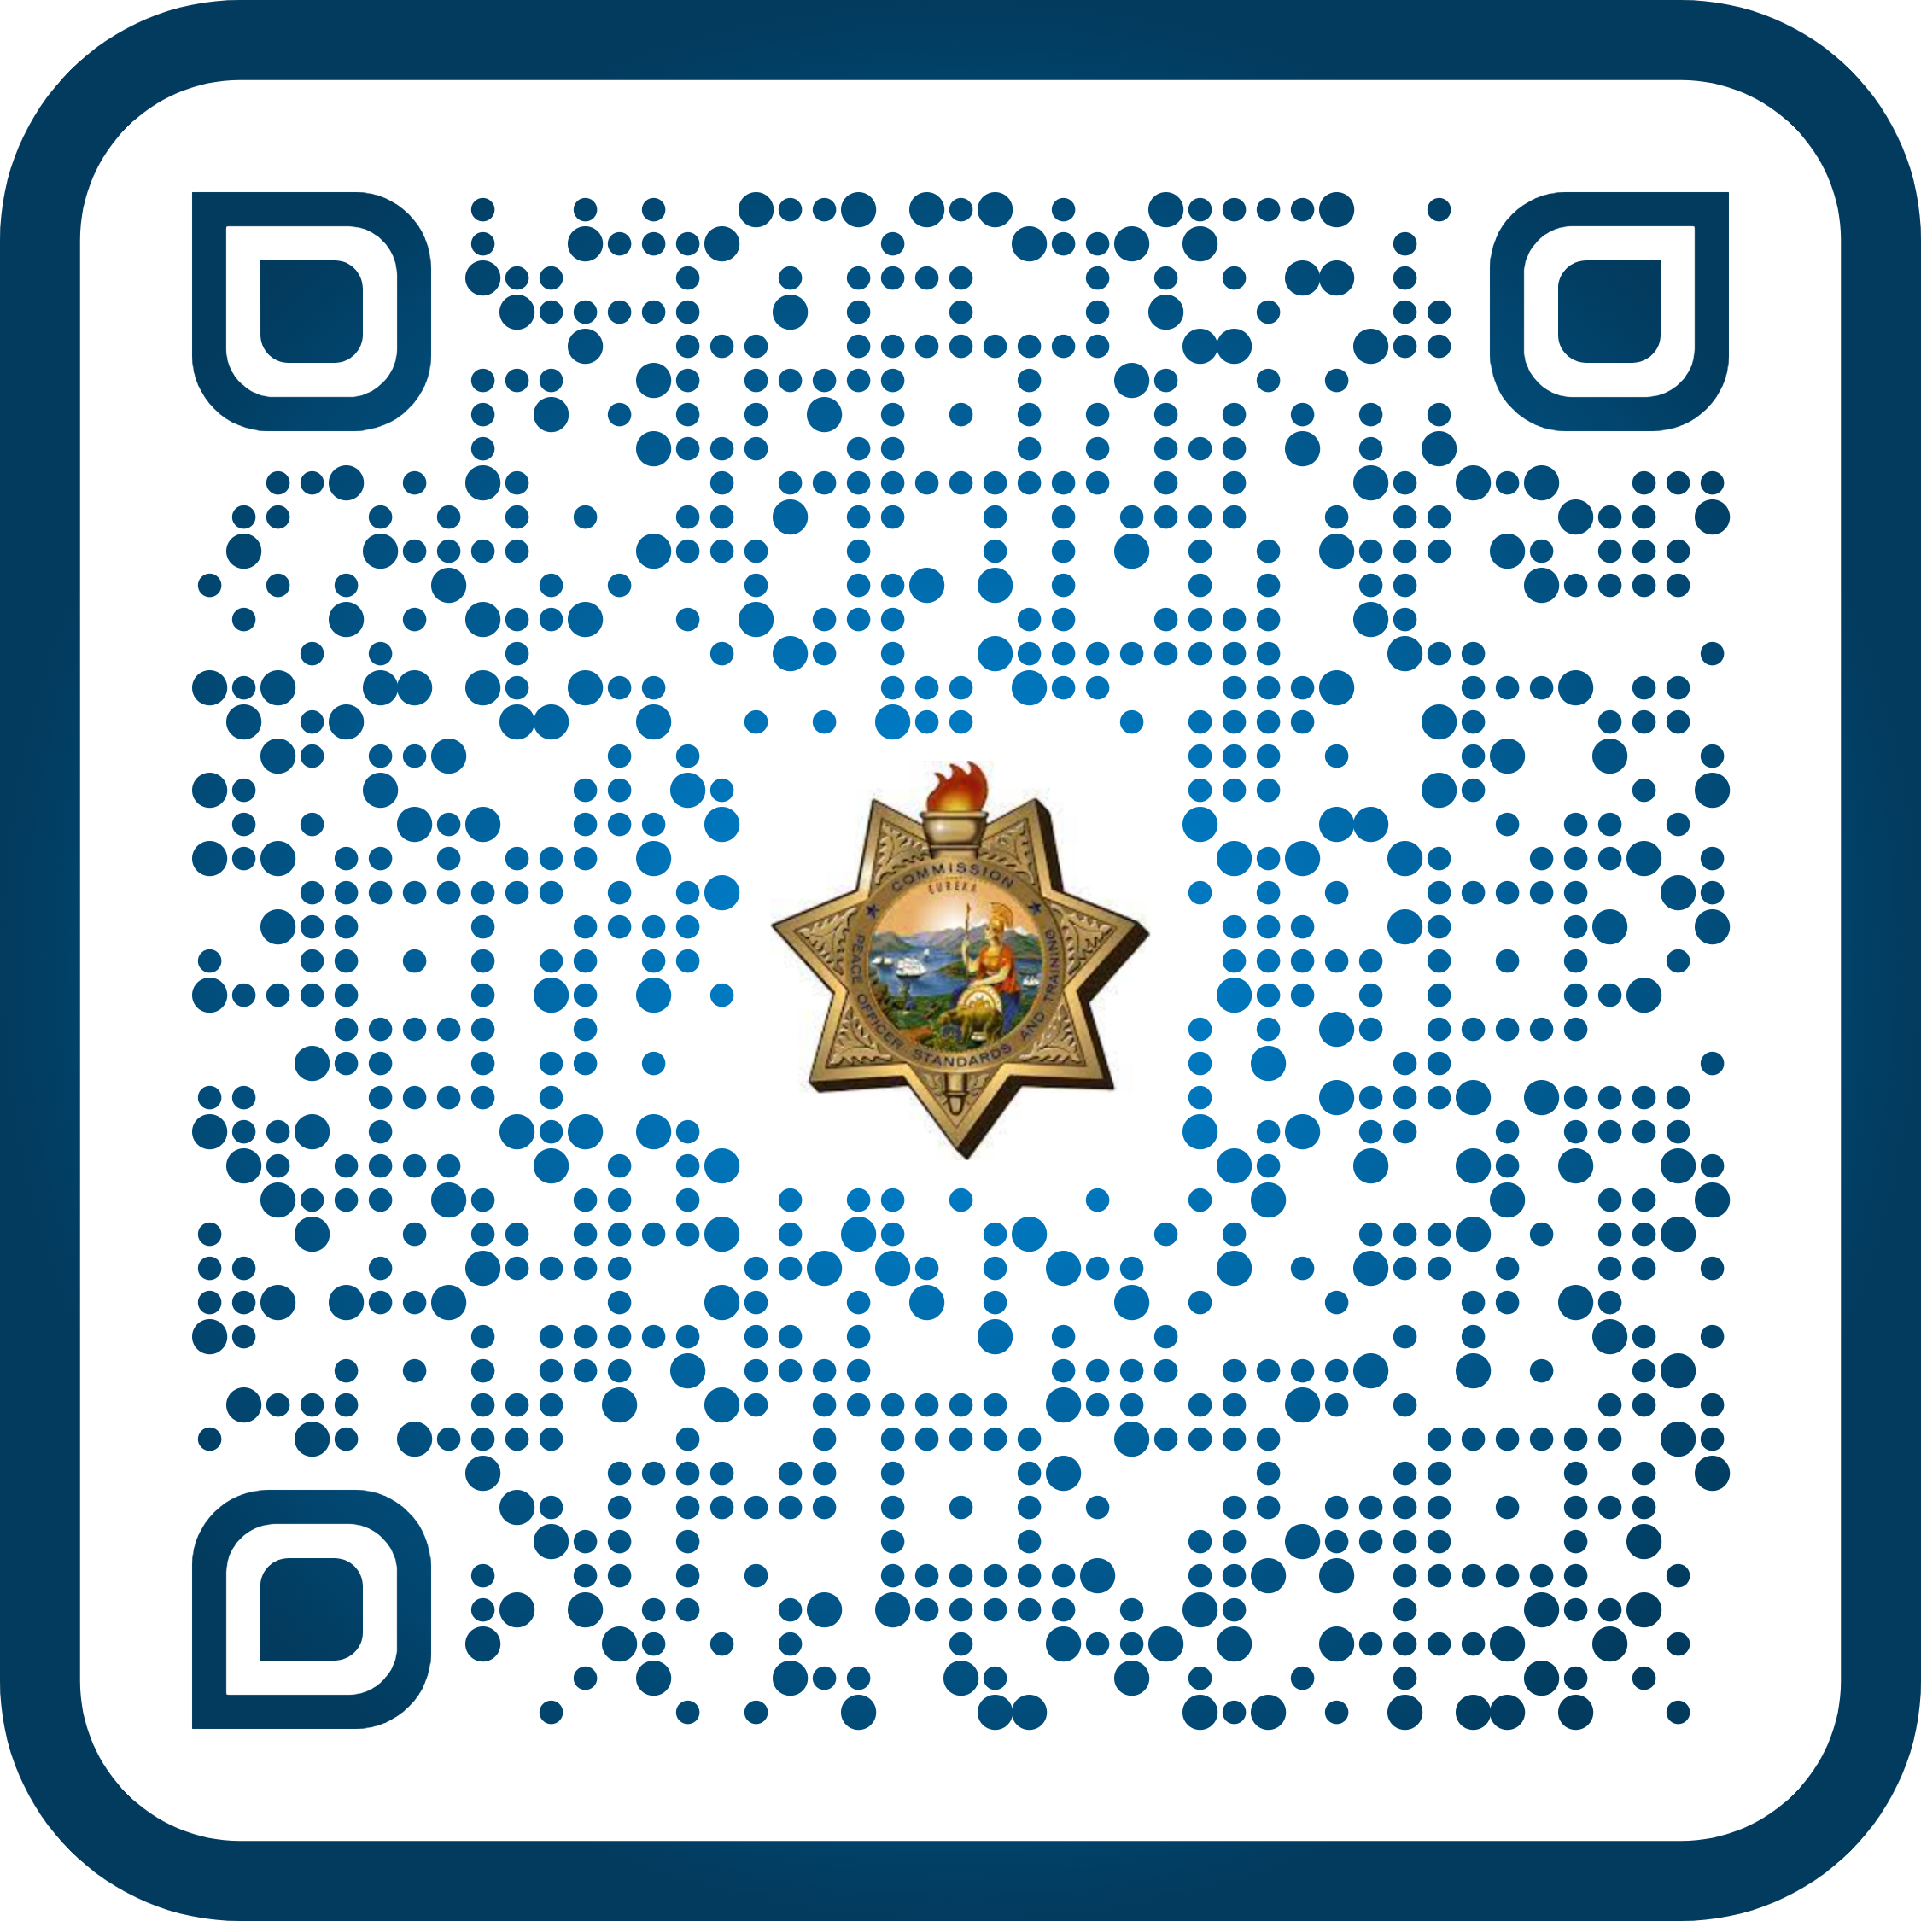
Where to Find Help
4. Training Managers Page on the POST Website
Great info, plus, this PowerPoint https://post.ca.gov/training-managers
5. Learning Portal Training that Meets Mandates
Notes:
Use the following links for additional information:
Press ENTER
Training Manager Page on the POST Website: This is where the PPT will be located
Press ENTER
Learning Portal Training that Meets Mandates: Use the link or the QR Code for more information.
Press ENTER

Slide 8
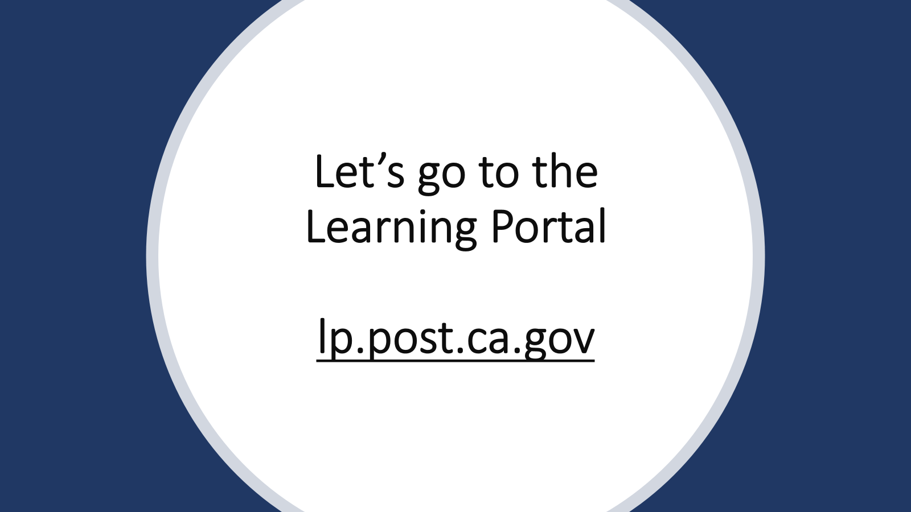
Notes:
Before we jump into the Learning Portal, are there any other questions?
Press ENTER

Slide 9
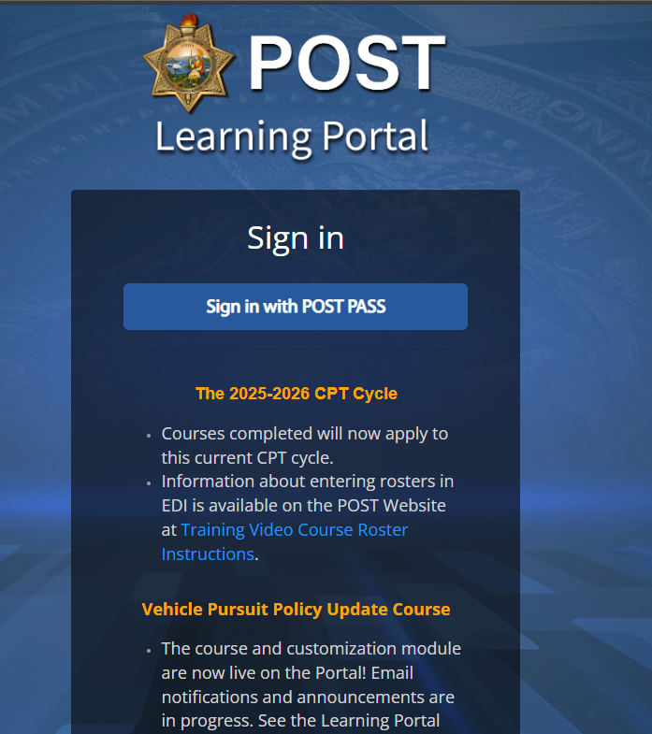
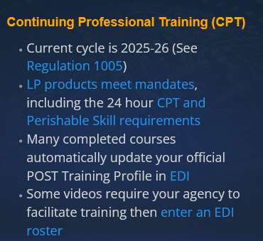
POST Learning Portal
Go to https://lp.post.ca.gov. DO NOT sign in yet.
Watch for Portal Status Alerts (Info, downtime, new releases)
Quick links to info and help. Click LP Updates.
Portal Support.
Click Sign in with POST PASS
See Info & Updates
Notes:
Press ENTER
POST Learning Portal
Press ENTER
Go to https://lp.post.ca.gov. DO NOT sign in yet.
Portal Status is listed below the sign in button. This can include portal downtime, new training releases, updated reports, etc.
Quick links are provided to give quick access to various websites (e.g., EDI, LP Updates, etc.). Click “LP Updates”. What information does it provide to you?
Portal Support
We are in the process of adding an LP AI ChatBot Assistant to assist with commonly asked questions. Feel free to look into this feature and see if it works for you. We are currently working on the interface to make it look more user friendly.
Now Sign in with POST PASS.
NOTE: All this information is located under the Sign In button. You should always review this content for updates before logging into POST PASS.
Press ENTER

Slide 10
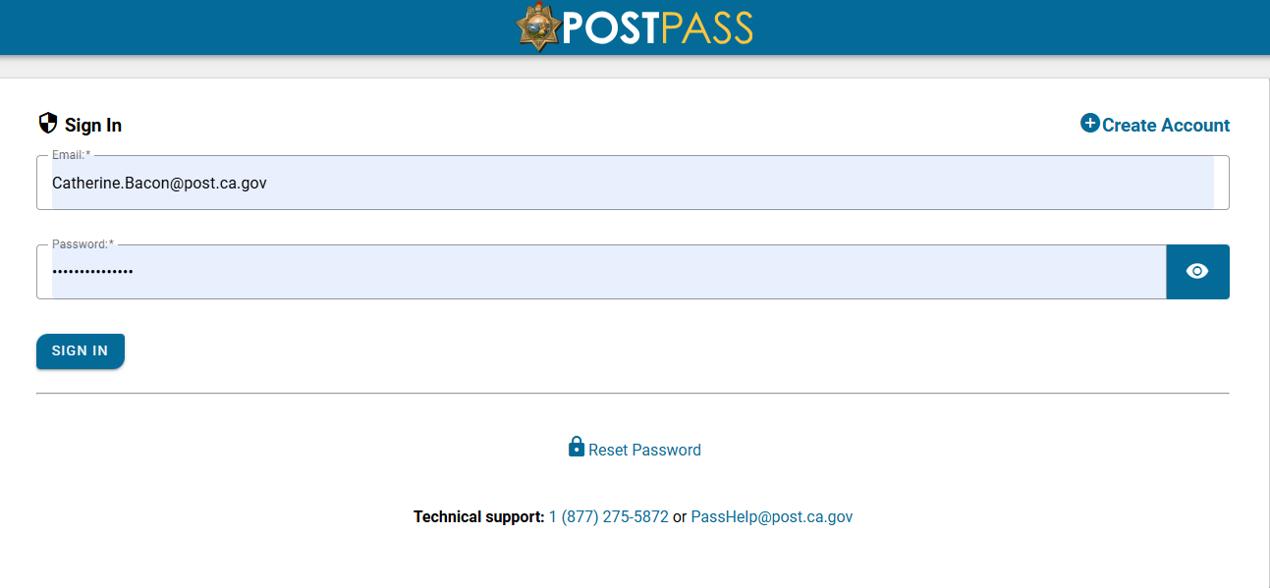
Sign In
Go to https://lp.post.ca.gov
Watch for Portal Status Alerts (downtime, new releases)
Quick link to Entering Rosters
Portal Support at bottom
Click Sign in with POST PASS
Notes:
Please press the Sign In Button and sign into POST PASS.
Press ENTER

Slide 11
Learning Portal Terms
Term | Meaning
Dashboard | The “landing” page when first logging into POST PASS.
Active Courses | Courses the learner is currently enrolled in.
Completed Courses | Find completion certificates. The learner can download, if needed.
Pending & Learning Paths | Aren’t used right now.
Enrollment | Active registration in a course from Register for Courses or when assigned a course.
Affiliation | Agency or Group in which the learner is currently employed.
Role | Who you are in the system and permissions you have: Learner/Manager.
Course | Title or topic for training.
Section | A breakdown of the course enrollments by CPT quarter*. Ends Dec 31, 2025.
Notes:
These are terms referred to in the Portal.
Dashboard: The “landing” page when you first log into POST PASS.
Active Courses: Courses in which the learner is currently enrolled.
Completed Courses: Find completion certificates. These can be downloaded by the learner, if needed.
Pending and Learning Paths: These are no currently used.
Enrollment: Active registration in a course from Register for Courses or when assigned a course.
Affiliation: This is the Agency or Group in which the learner currently is employed with.
Role: Who you are in the system and permissions you have: either Learner or Manager.
Course: This is the title or topic for the training.
Section: Quarterly enrollments allow courses to be offered every three months. At the end of three months, if the courses are not completed, the learner will be placed into a new Section or quarterly enrollment and have to start the course over again. Quarters are as follows: July to September, October to December, January to March, and April to June.
Press ENTER

Slide 12
Activity
Learner View and Register for Courses
Notes:
Next, we will be looking at the Learner View and Registering for courses.
Press ENTER

Slide 13
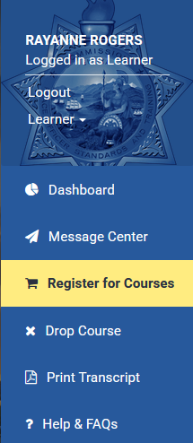
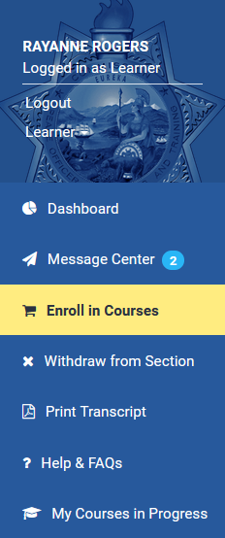
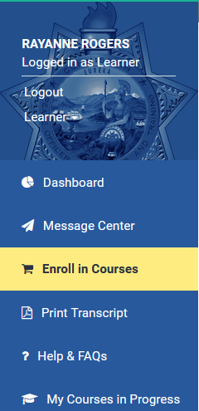
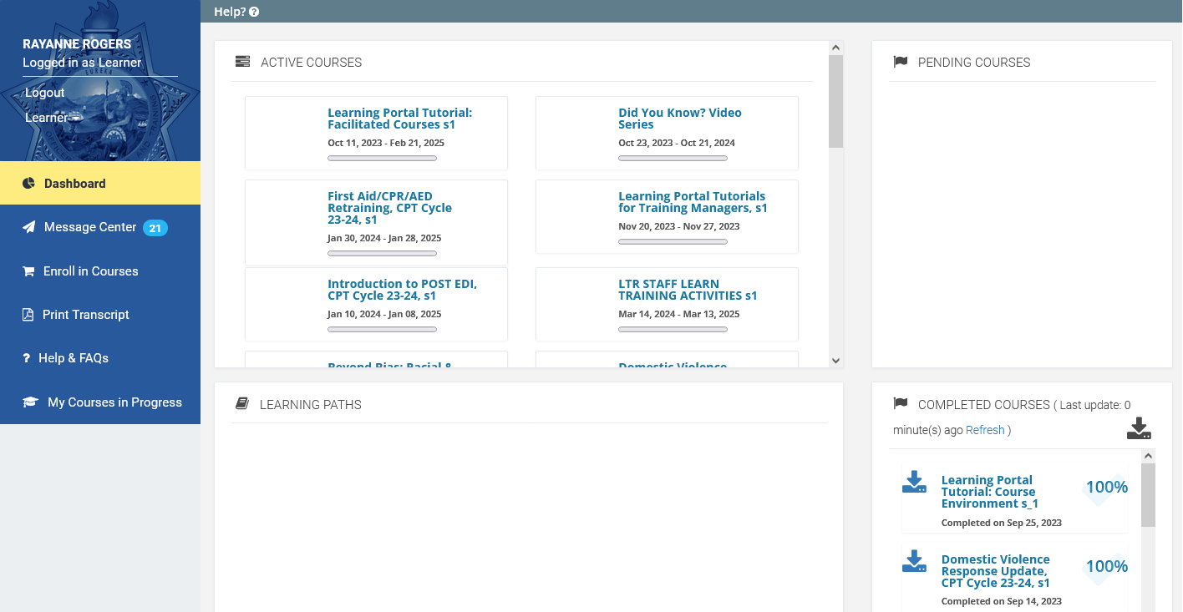
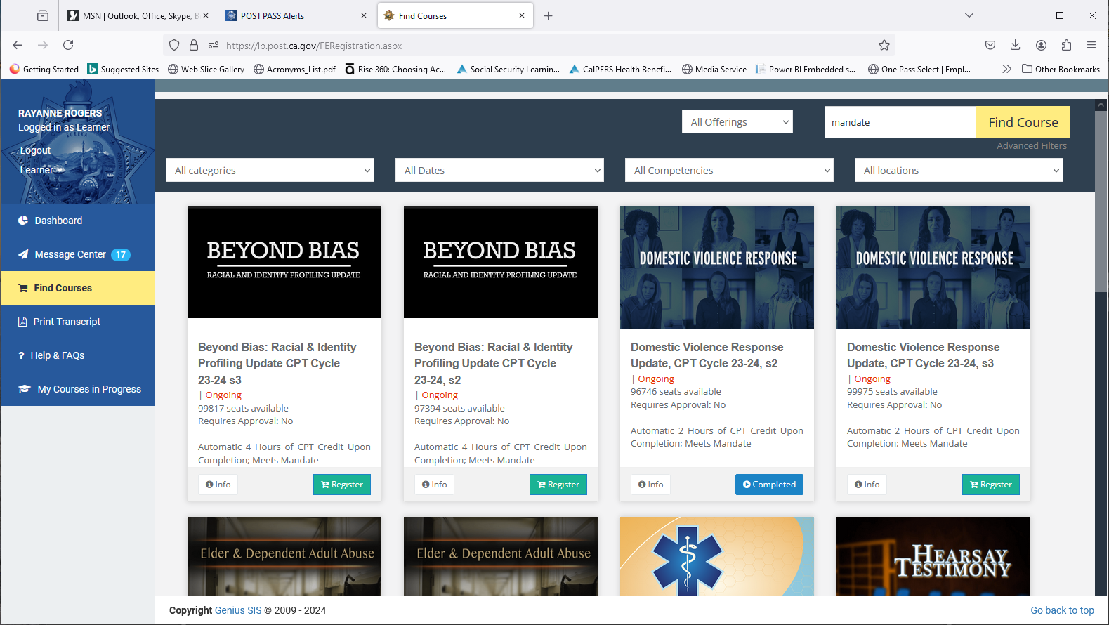
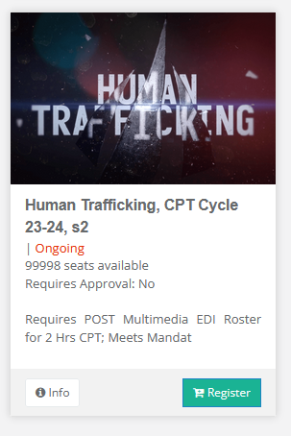
Click Register for Courses
Many Topics
Some Meet Mandates
Continuing Professional Training (CPT)
Notes:
You are on your Dashboard as a Learner which is the default. Once a Learner is enrolled in a course section, it will appear in their dashboard.
The Message Center shows enrollment and other messages from the Portal, including course completions.
Look at your active courses. If you are already an LP Admin you were assigned the training manager tutorials and the facilitated courses. Those are in your dashboard to learn from and/or use for training. These will not have completion dates, so the courses will remain on the dashboard for easy access.
The complete courses corner has your certificates of completion for courses that were taken in this Learning Portal. You can download them all.
Common Question: Can I download other learners' transcripts from this screen? No. Transcripts give you some similar info and we’ll go over that when we change to your training manager role. Let’s find other courses to take. Click (Press ENTER) Register for Courses for the catalog of additional courses.

Slide 14
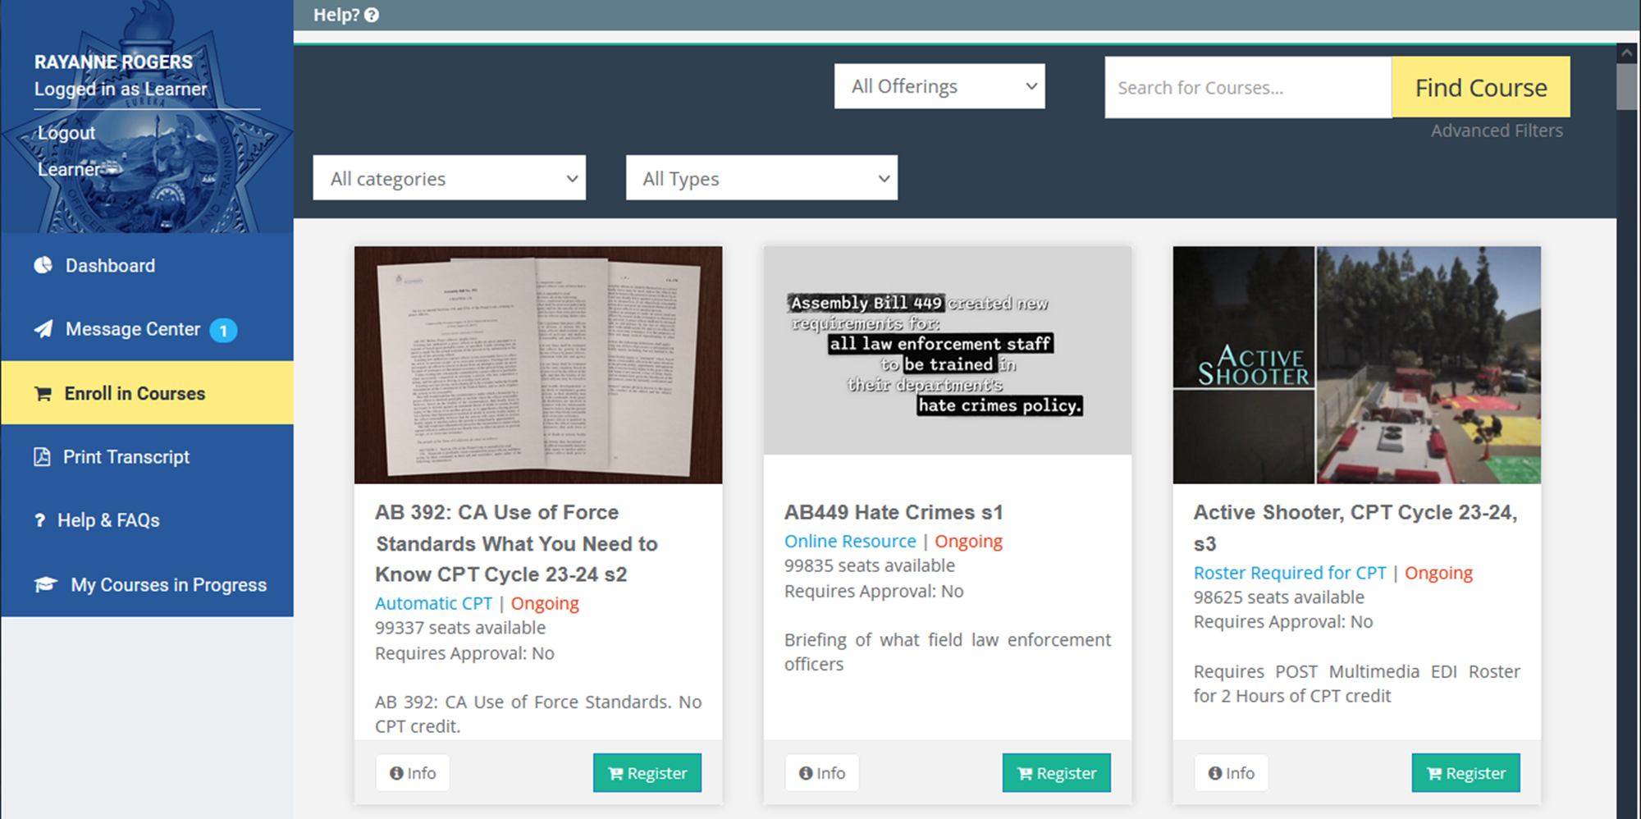
Automatic CPT
Online Resource
Roster Required for CPT
Notes:
Under Register for Courses (the online course catalog), there are many topics, most meet CPT mandates, some meet specific mandates, facilitated video training programs can help for group settings that need to be discussed, did you know videos, and self paced training videos for automatic CPT.
Press ENTER
Each “card” or course indicates if automatic CPT is offered or if a multimedia roster needs to be entered in EDI for credit.
The automatic CPT training has quizzes/tests, interactions, and feedback as if an instructor is involved but they are self-paced.
The training that requires an EDI roster has a companion facilitated version, student guide, and overview guide PDFs that, you as a training manager with LP admin access, can discuss or facilitate a session or have a discussion, or allow an instructor to teach from. This is where you, as the Training Manager, are responsible to ensure learning took place. There are guides for facilitation, student participation and an overview of a topic. We’ll go over where those are located on the learning portal.
You also can find mandates on the website. A link to this is provided later. https://post.ca.gov/Learning-Portal-Training-that-Meets-Mandates
Press ENTER

Slide 15
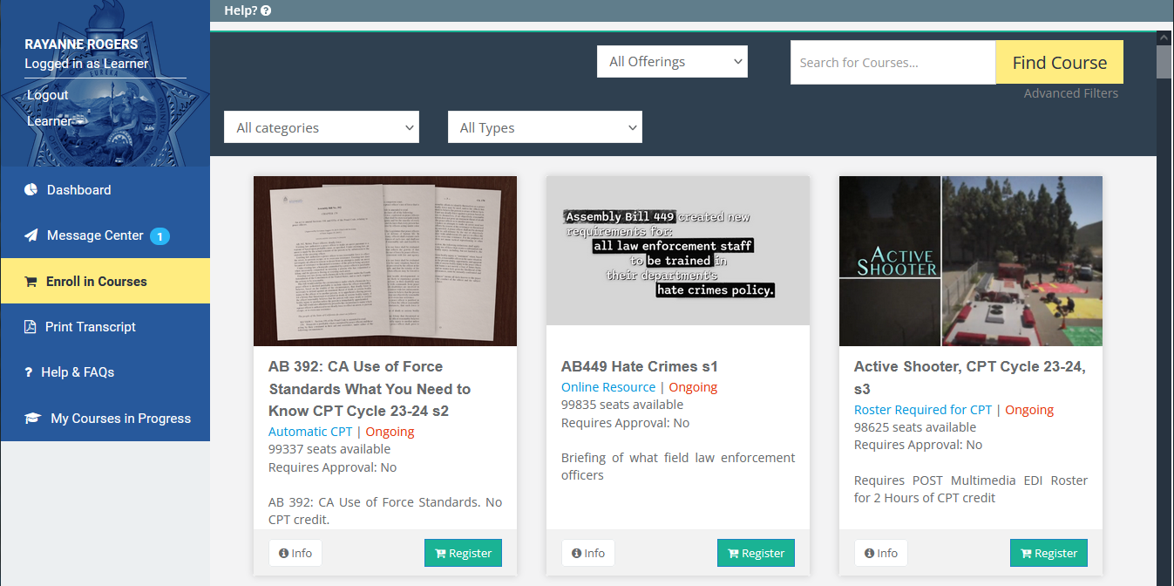
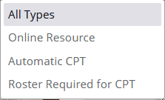
Click on
All Types
Notes:
To help you find what you need, there are a few ways to filter and search, such as Categories and types. Example: Automatic CPT.
Press ENTER
Click “All Types”, select (Press ENTER) “Automatic CPT”. Your list has now been updated.
The search features now have more detail such as (Press ENTER) “roster required”, “mandates”.

Slide 16
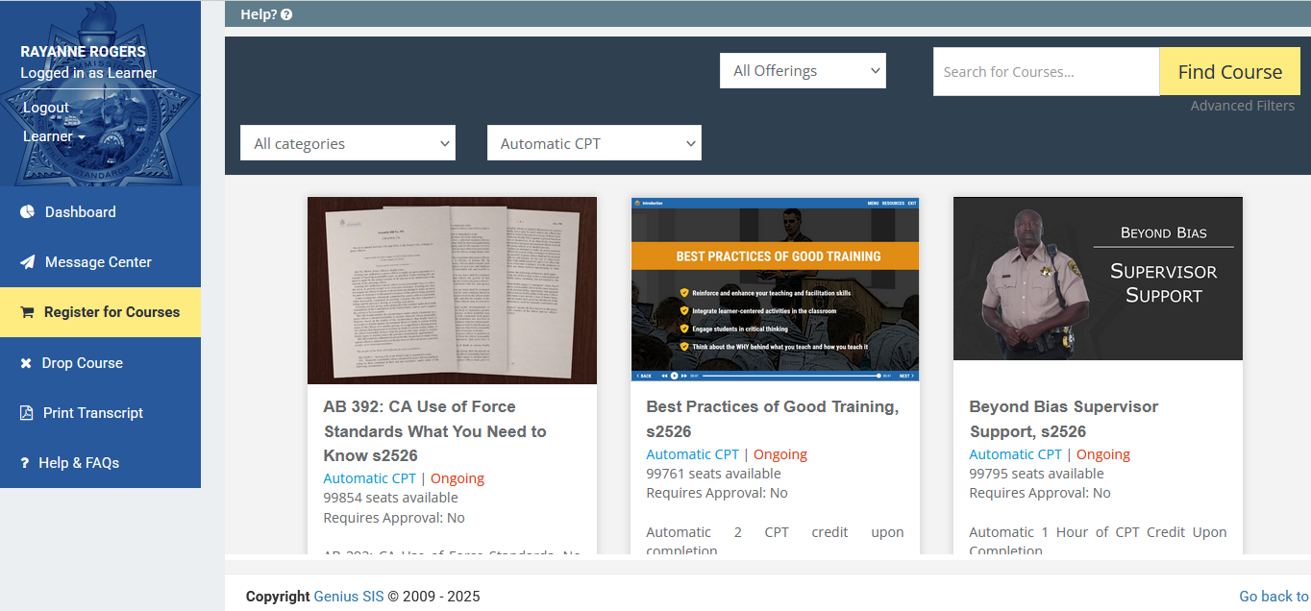
Enter the word “mandate” in Search
Click Find Course
Notes:
You can also search for topics or categories. Enter (Press ENTER) “mandate” in Search to see the courses that meet mandates.
Press ENTER
See how all courses that meet a mandate have populated.
Press ENTER

Slide 17
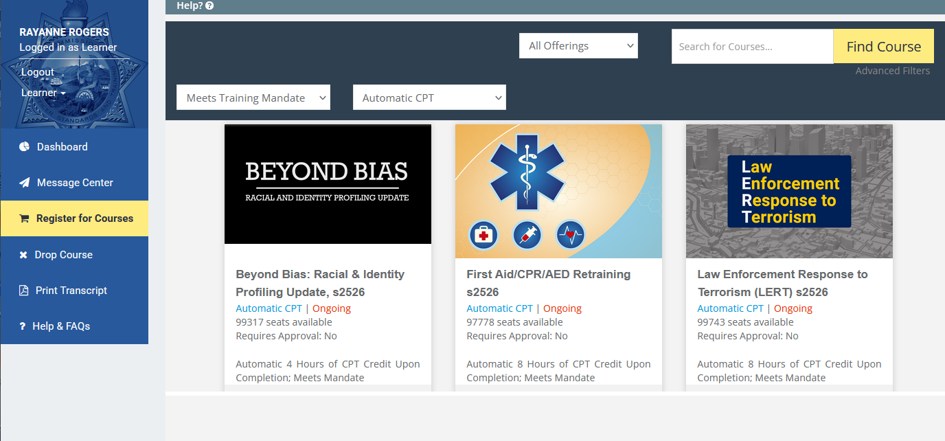
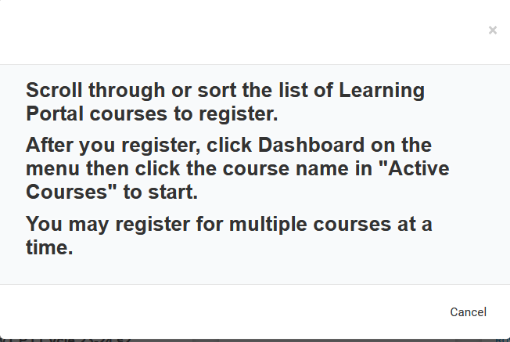
Help Feature
Notes:
Also there’s a Help Feature is available throughout the Portal. It will give you a brief description of what’s going on for the page you are on.
Press ENTER
Press ENTER

Slide 18
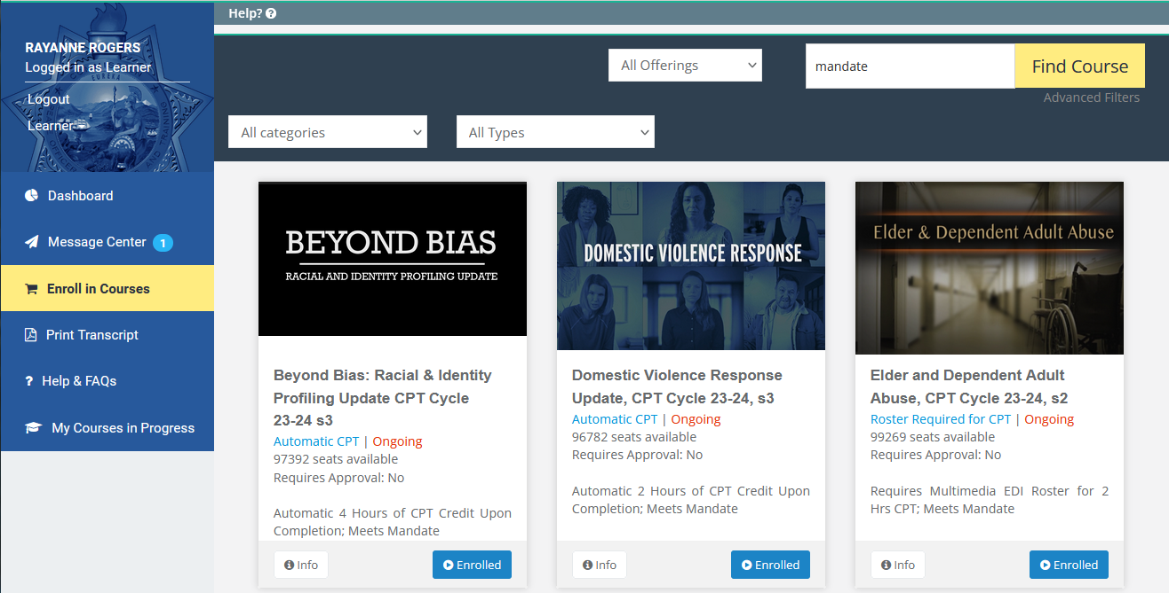
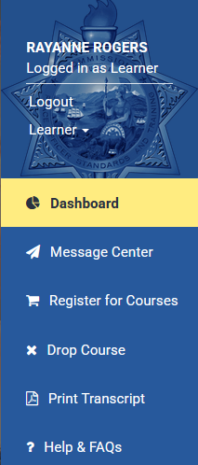

Then Click Dashboard to Start
Click Register to enroll in a course
Notes:
Let’s see how you access a course as a Learner. Your agency may have questions on this….Find the course you want.
Press ENTER
Click Register to Enroll. Enrolling puts the course on your Dashboard.
Press ENTER
Go back to the Dashboard to start a course.
Press ENTER

Slide 19
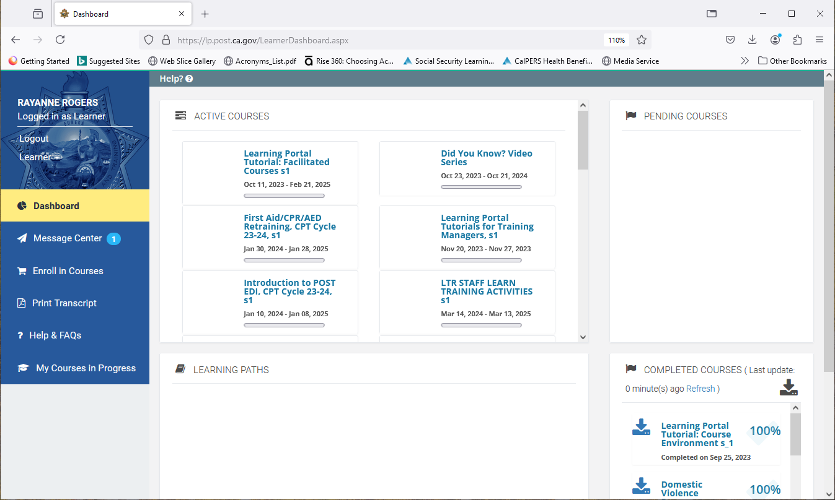
Click to Open the Training
Notes:
To open the course, Press ENTER, click on it to open.
Press ENTER

Slide 20
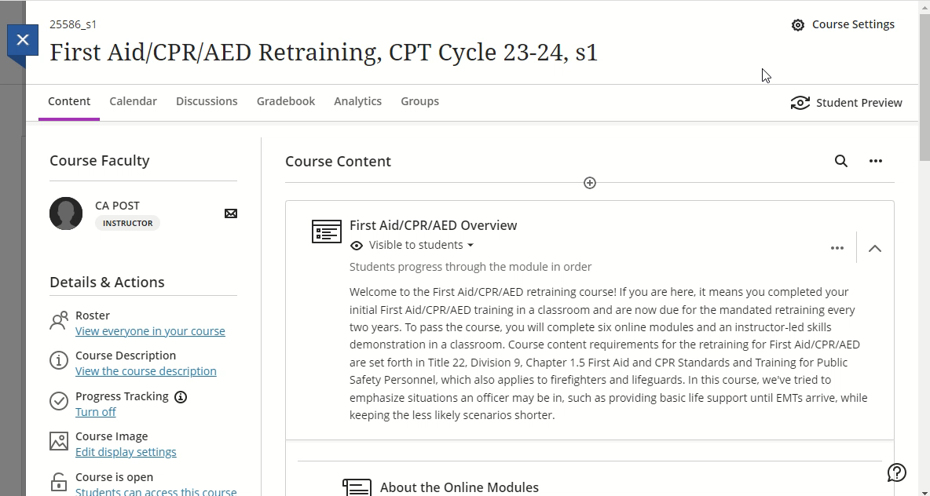
CLOSER LOOK: First Aid/CPR/AED Retraining
Notes:
Play this video for a walk through
This shows the First Aid/CPR/AED Retraining course outline.
First learners will need to complete all 6 modules online in Portal.
Details on the online modules and the skills demo date entry are all written out. Take time to read through.
Second, learners will need to attend the in-person skills demonstration when the first part is complete. The Learner will then go back to the Portal and enter the date they completed the skills demonstration. NOT the date they are entering the information. They will receive CPT credit once these 2 steps are done.
Press ENTER

Slide 21
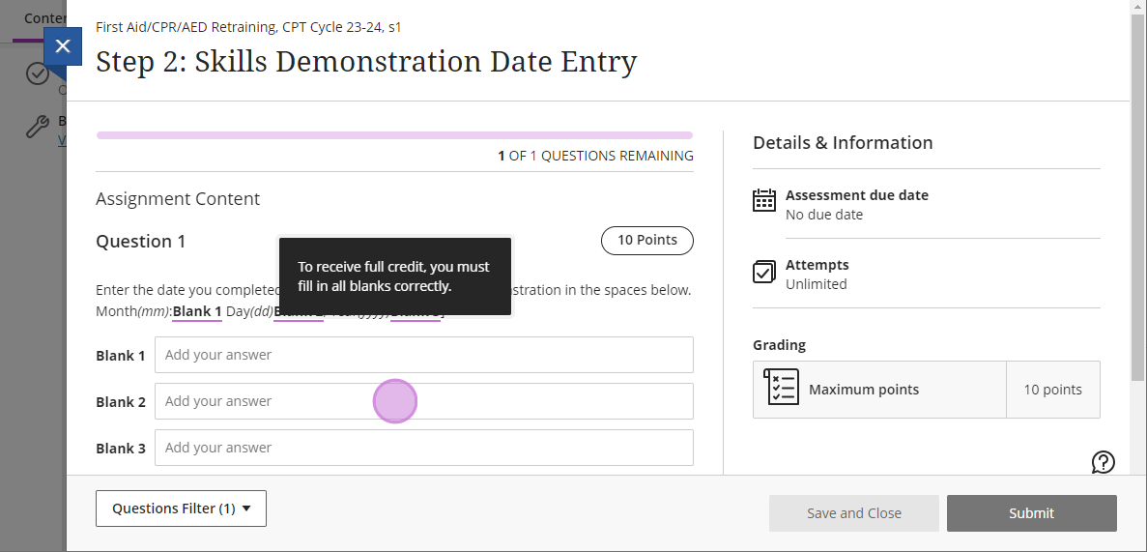
First Aid/CPR/AED Retraining
Month = mm
Day = dd
Year = yyyy
Notes:
Once in-person skills demonstration is complete, Press ENTER
Learners must enter the skills demonstration date as shown:
2 digit month
2 digit day
4 digit year
Question:
If the skills demonstration was completed on June 3, 2025, how would it be entered? 06-03-2025
If the skills demonstration was completed on October 11, 2025, how would it be entered? 10-11-2025
Press ENTER

Slide 22
End of Year Course Update
ALL POST Learning Portal courses, including both parts of the First Aid/CPR course, MUST be completed by December 31, 2025. The First Aid/CPR Skills Demonstrations date MUST also be entered by this date. Incomplete progress in any course WILL RESET, and progress will be lost.
For more information, refer to Bulletin 2025-17. For questions, contact Learning Portal Support at support@postportal.Atlassian.net or at (916) 970-4650.
Notes:
End of Year Course Update
Press ENTER
ALL POST Learning Portal Courses, including both parts of the First Aid/CPR course, MUST be completed by December 31, 2025. The First Aid/CPR Skills Demonstration date MUST also be entered by this date. Incomplete progress in any course WILL RESET, and progress will be lost.
Press ENTER
For more information, refer to Bulleting 2025-17. For questions, contact Learning Portal Support.
Questions:
Can a First Aid/CPR course completion in 2025 have a skills demonstration date of January 12, 2026?
What will happen?
What do you need to do as a Training Manager if learners have completed Part 1 of the First Aid/CPR course?
Press ENTER

Slide 23
Drop a Course
Notes:
Now we will review how to Drop a Course.
Press ENTER

Slide 24
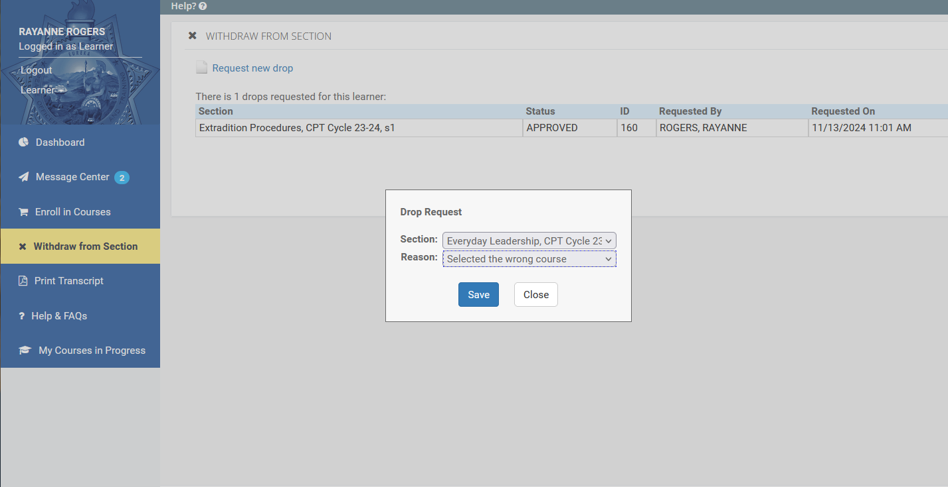
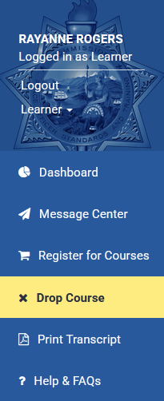
Request new drop
Find the Title, select the Reason,
Click Save
Drop Course
Notes:
You can also Drop a Course you are no longer interested in or aren’t going to complete to remove it from your Dashboard.
Press ENTER
Select drop course.
Press ENTER
Press ENTER
Request new drop.
Press ENTER
Select the title and reason of drop. Click Save.
Press ENTER

Slide 25
Training Manager Administrator Tools
  How?
  Fill out Form 2-339 (POST Website/Forms)
  Switch roles under your name
  Gives you a new dashboard view
  What?
  Manage Learner Lists
  Assign Training, Run Reports
  Monitor Completions and Transcripts
  Add Non-Peace Officers, if necessary
  What else?
Course Customization – Vehicle Pursuit Policy
Facilitated Courses with Training Materials
  EDI Roster Entry for Multimedia Courses
Notes:
Training Manager Administrator Tools
Press ENTER
How?
Fill out Form 2-339 (POST Website/Forms)
Switch roles under your name.
Gives you a new dashboard view.
Press ENTER
What?
Manager learner lists
Assign training, run reports
Monitor completions and transcripts
Add Non-Peace Officers, if necessary
Press ENTER
What Else?
Course Customization – Vehicle Pursuit Policy
Facilitated Courses with training materials
EDI Roster entry for multimedia courses
Press ENTER

Slide 26
Activity
Training Manager View
Notes:
Now on to your LP Admin/Manager role details.
How do you know you have the Manager (Admin) role in the Portal? Lets Review.
Press ENTER

Slide 27
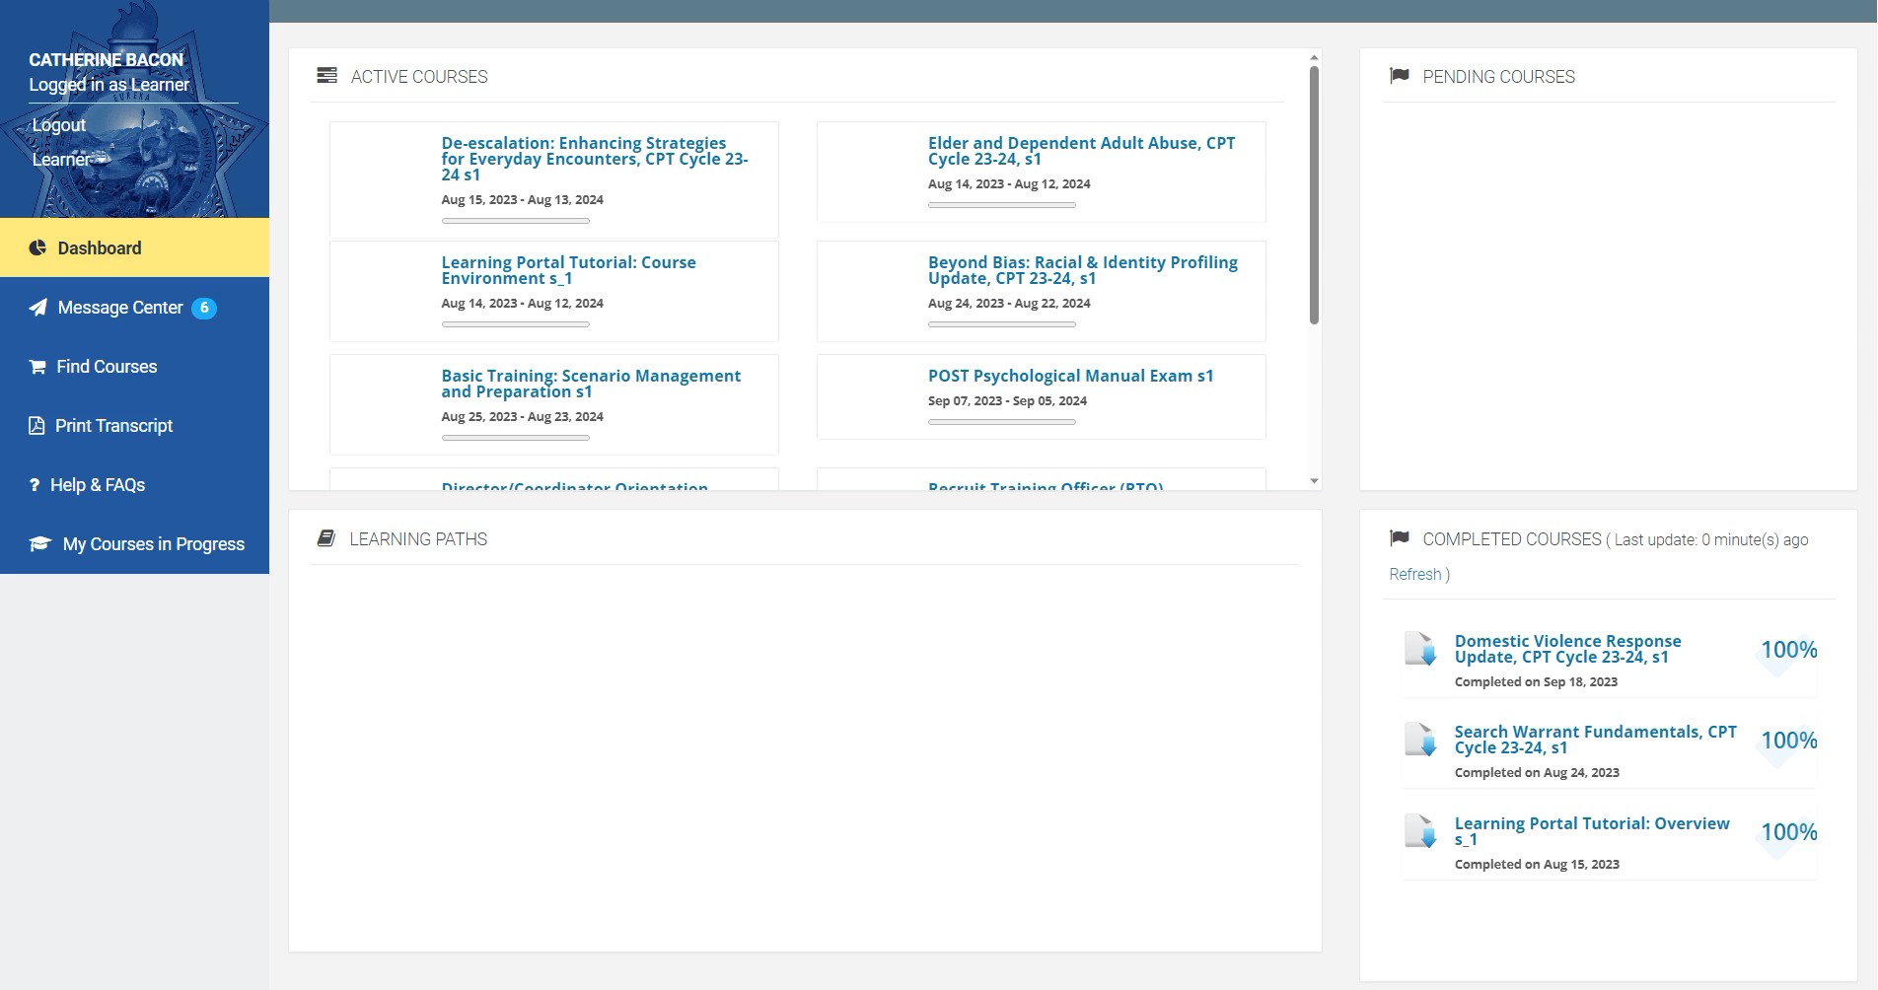
Notes:
Play this video for a walk through
To change to your Manager role…
Click under your name and change from Learner to Manager.
You now see a dashboard, a high-level look of Portal activity and accounts, for your agency
To go back as a Learner, go the right side and click Learner under your name
Then go back to Manager from the left Learner drop down
This is how you go back and forth.
Press ENTER

Slide 28

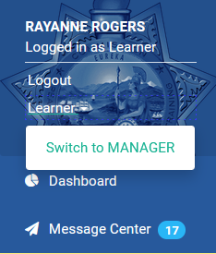
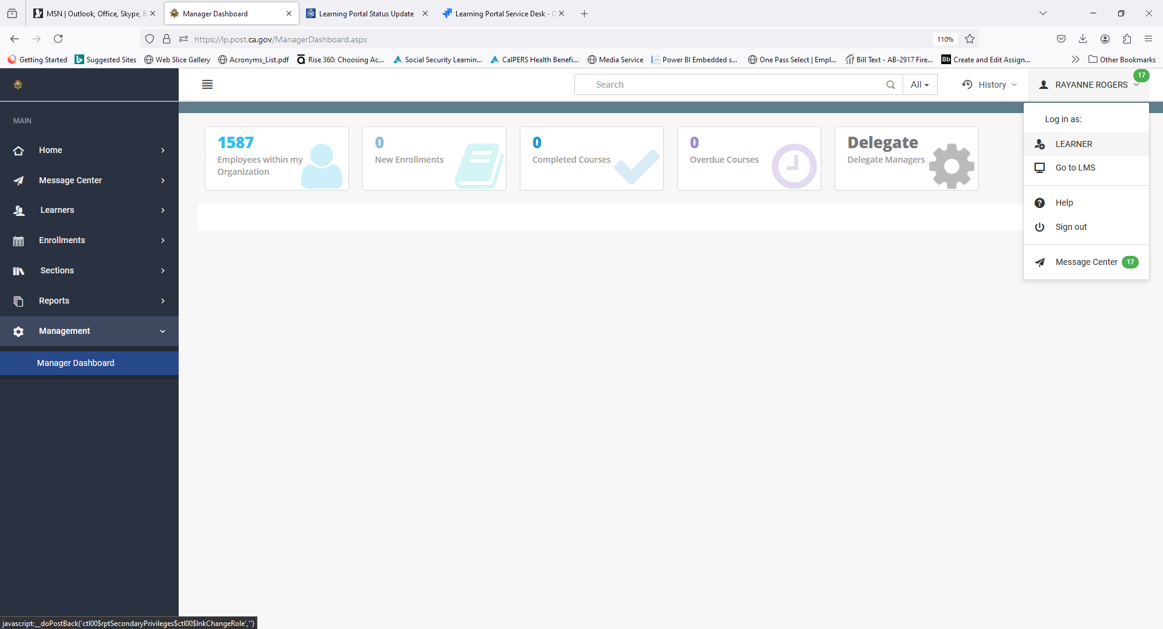
WRITTEN STEPS: Change from Learner to Manager
1.
On the left side, click under your name and click Switch to Manager (if you don’t see that, make sure the you completed Form 2-339 and submitted to LP Support)
You see information for your agency
To go back as a Learner, go the right side and click Learner under your name
We’ll go back to the Manager role.
3.
Notes:
Here are the written-out steps to change from Learner to Manager.
On the left side, click under your name and select Switch to Manager. If you do not see this option, make sure you completed Form 2-339 and submit to LP Support.
You will see information for your agency.
To go back to the Learner dashboard, go to the right side and click Learner under your name.
To go back to the Manager role, click under your name and select Switch to Manager.
Press ENTER

Slide 29
Activity
Lookup Learners
Notes:
Has anyone needed to lookup learners before?
If yes, what did you do to find them?
Press ENTER

Slide 30
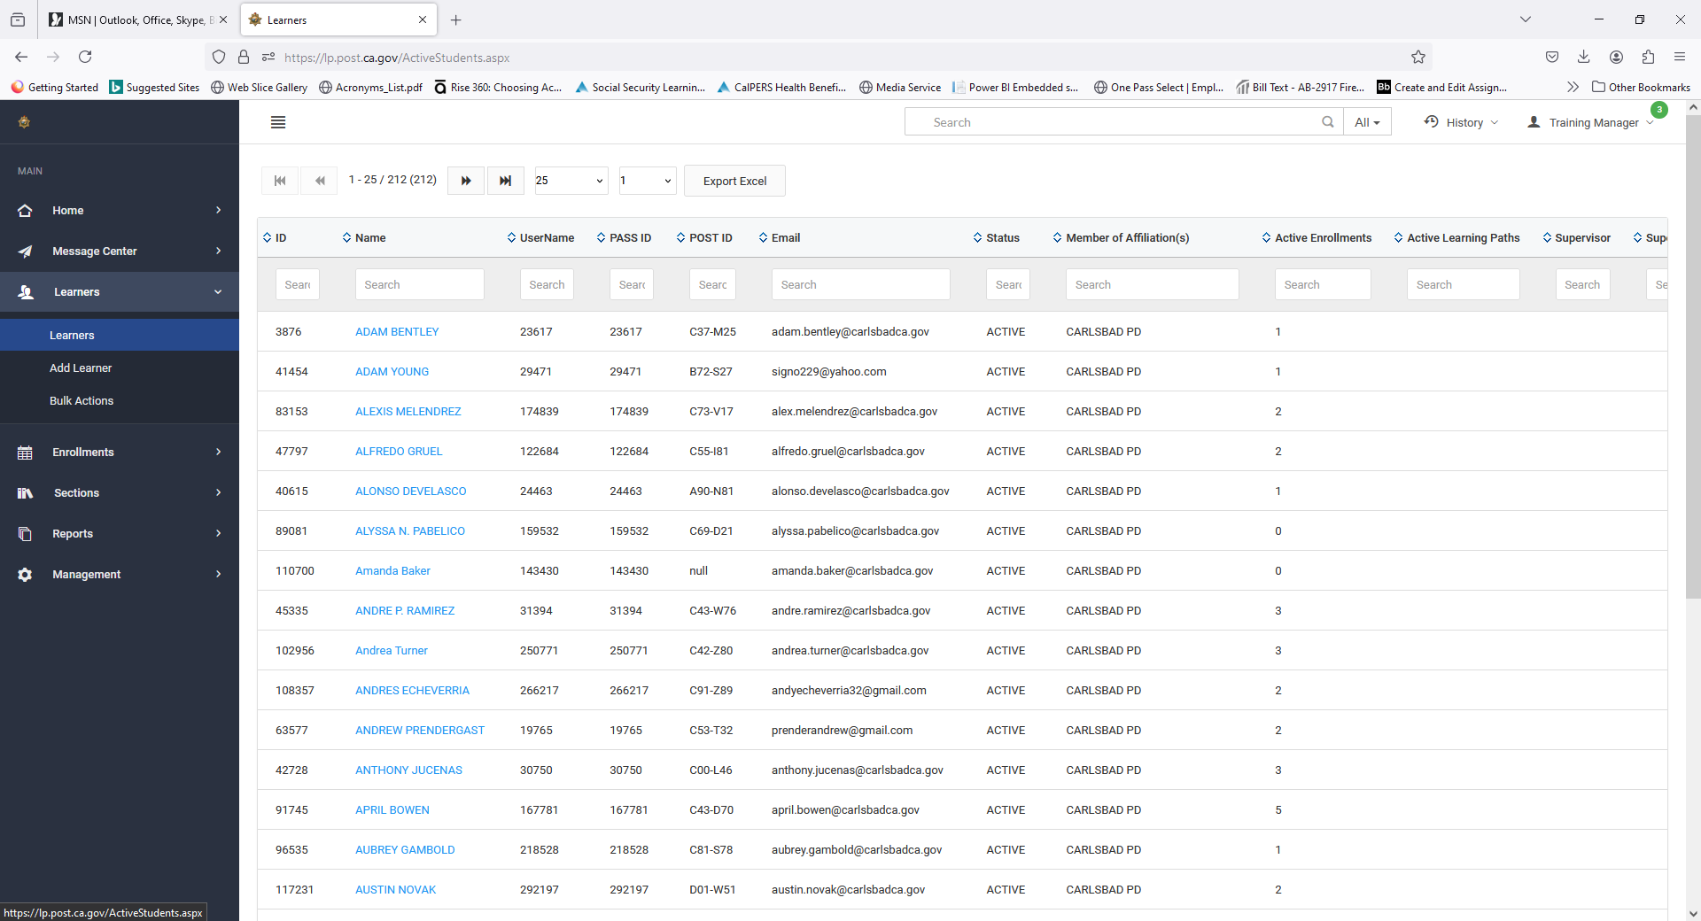
STEPS: To Search Learners
1. Click Learners
“Learners” shows your agency’s accounts in the Portal
  Enter name, POST ID, or email, etc in the search columns
Click on a Learner to see details on activities, enrollments, etc
2. Click on Name of Person
Notes:
Step by step
Press ENTER
Learners show in your agency affiliation in the Portal. Enter a name, or POST ID or email, etc. in the search columns.
Press ENTER
Click on the Learner to see details on activities, enrollments, etc.
Press ENTER

Slide 31
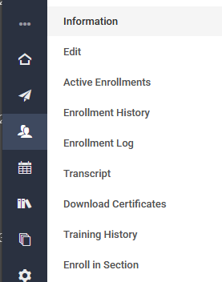
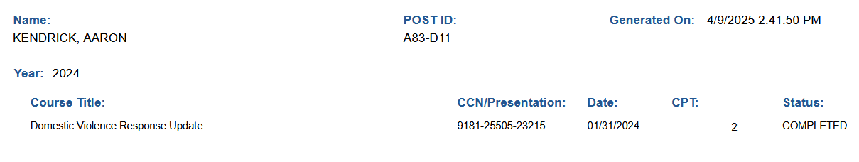
3. Enrollment History or Transcript
These are helpful areas…
  Enrollment History shows a summary of courses. This can be exported to excel.
  Downloadable Transcript shows a summary of completions.
Last, First A99-Z99
Notes:
Press ENTER
Enrollment History or Transcript
Press ENTER
These are helpful areas…
Press ENTER
Enrollment History shows a summary of courses. This can be exported to excel.
Downloadable Transcript shows a summary of completions.
Question?
Will a course that is in progress appear on the transcript? No. Why? It is not completed.
Press ENTER

Slide 32
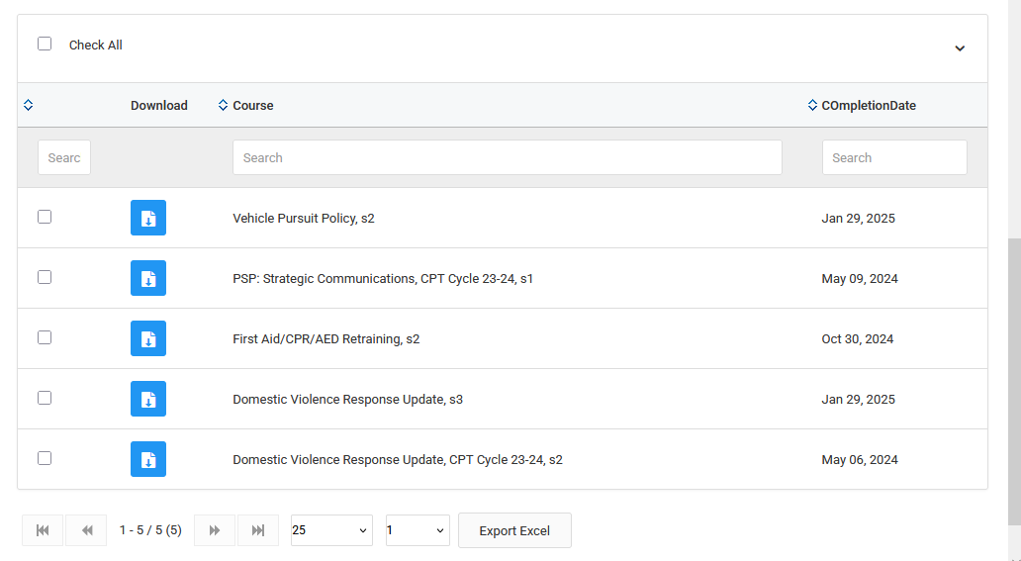
NEW feature!
  Downloadable Completion Certificates
  Scroll down and select specific Course titles
4. Download Certificates
5. Click the Blue Download button
Notes:
Press ENTER
New Feature: Downloadable Certificates of Completion.
You can scroll through all titles and select the specific Course of interest.
Press ENTER
Click the Blue Download Button
Press ENTER

Slide 33
Non-Peace Officers
Notes:
Now we will discuss adding Non-Peace Officers.
How many of you have added a Non-Peace Officer?
How did it go for you?
Press ENTER

Slide 34
Who qualifies as a Non-Peace Officer?
  A person who is…
  An employee or volunteer of your agency (clearance checked)
  Employed as an instructor at your agency such as for AICP, RBC, or SBIC
  No EDI records kept. No CPT.
  You are responsible for their activity in the Portal.
  
  
Notes:
Who qualifies as a Non-Peace Officer?
Press ENTER
If the person is…
Press ENTER
An employee or volunteer of your agency (clearance checked).
Press ENTER
Employed as an instructor at your agency such as for AICP, RBC, or SBIC
Press ENTER
No EDI records kept. No CPT.
Press ENTER
You are responsible for their activity in the Portal.
Press ENTER

Slide 35
Yes or No?
Who can you add as a Non-Peace Officer…
…A person who has a Notice of Appointment (NOA) or is awaiting the NOA processing in EDI?​
  No. Have them login to the Portal follow the instructions to create a PASS account or update their password.
  …A person who is a Dispatcher at your agency?
  No. Have them login to the Portal follow the instructions to create a PASS account or update their password.
  Why?
  EDI is the system of record for all profiles and data. The Portal checks with EDI and allows or doesn’t allow usage dependent on the NOA status.
  
  
Notes:
Who can you add?
Press ENTER
…A person who has a Notice of Appointment (NOA) or is awaiting the NOA processing in EDI?​
Press ENTER
No. Have them login to the Portal follow the instructions to create a PASS account or update their password.
Press ENTER
…A person is a Dispatcher at your agency?
Press ENTER
No. Have them login to the Portal follow the instructions to create a PASS account or update their password.
Press ENTER
Why?
Press ENTER
EDI is the system of record for all profiles and data. The Portal checks with EDI and allows or doesn’t allow dependent on the NOA status.
Press ENTER

Slide 36
Yes or No?
Who can you add as a Non-Peace Officer…
  …A person who has retired from LE and is not currently sworn but is employed by your agency in an NPO capacity?
  Yes. You may add them as an NPO.
  …A private presenter?
  No. You may not add them as an NPO.
  …Proctors?
  No. You may not add them as an NPO.
  Contact the BTB or SCR Bureaus at POST.
  
  
  
Notes:
Who can you add as a Non-Peace Officer?
Press ENTER
…A person who has retired from law enforcement and is not currently sworn but is employed by your agency in an NPO capacity?
Press ENTER
Yes. You may add them as an NPO.
Press ENTER
…A private presenter?
Press ENTER
No. You may not add them as an NPO.
Press ENTER
…Proctors?
Press ENTER
No. You may not add them as an NPO.
Press ENTER
Contact the BTB or SCR Bureaus at POST.
Press ENTER

Slide 37
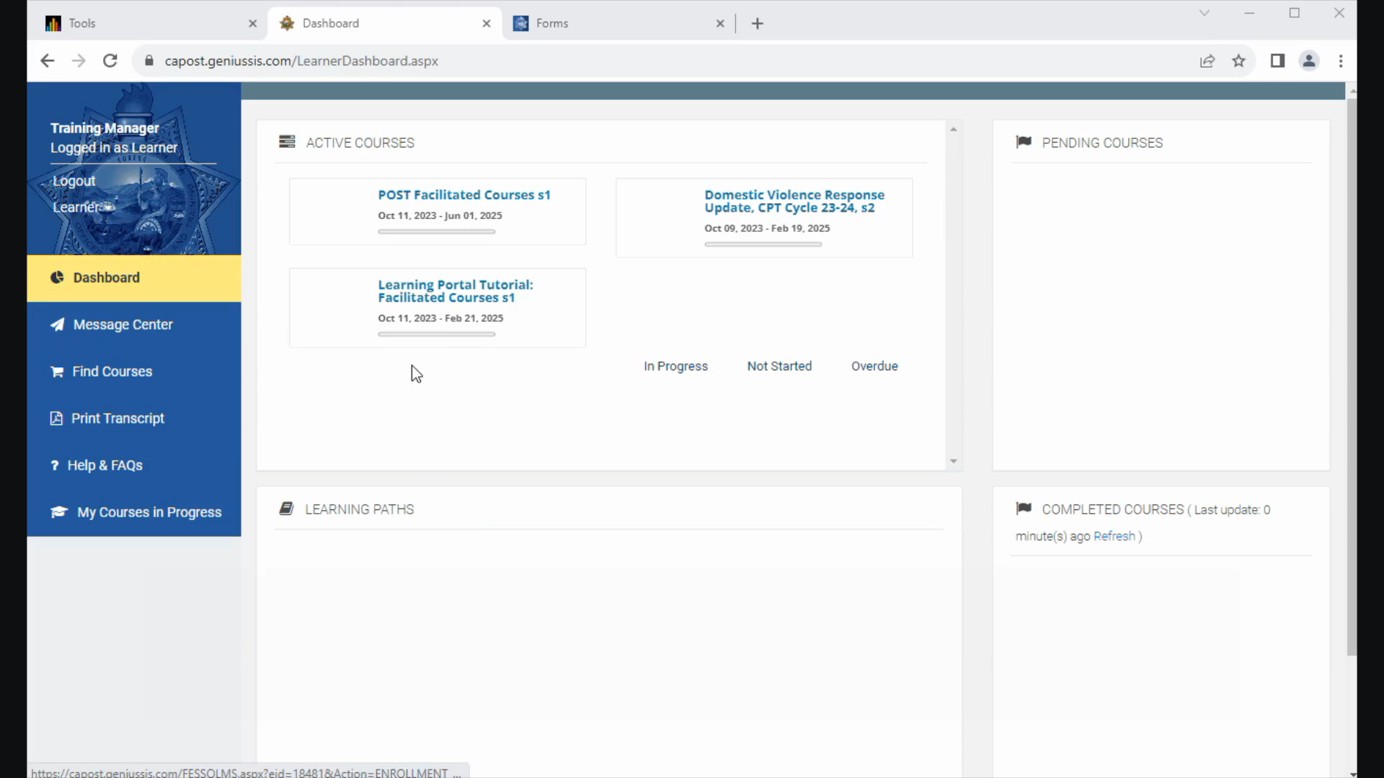
Notes:
Play this video for a walk through
How to add Non-Peace Officers from your Manager role.
Go to Learners, Add Learner.
Enter the required fields in blue and the Affiliation.
Leave PASS ID field blank. POST ID needs to be set to “0” and will automatically update when user logs in.
Mark the NPO as Yes. Account expiration is set for 2 years from date entered.
In the future, you can renew or end the NPO’s access by changing the date.
More details on managing NPOs will be in a future tutorial.
Press ENTER

Slide 38
STEPS: Add Non-Peace Officers
Go to Learners, Click Add Learner
Enter the required fields in blue and the Affiliation (your agency)
Leave PASS ID field blank
Enter 0 for the POST ID.
  It will automatically update when the NPO user logs in.
Mark the NPO as Yes.
  Account expiration is set for 2 years from date of entry.
In the future, you can renew or end the NPO’s access by changing the date
Notes:
Adding Non-Peace Officers Review:
Go to Learners, click add learner.
Enter the required fields in blue and the Affiliation (your Agency).
Leave the PASS ID field blank.
Enter “0” for the POST ID.
It will automatically update when the NPO user logs in.
Mark the NPO as Yes.
Account expiration is set for 2 years from date of entry.
In the future, you can renew or end the NPO’s access by changing the date.
Press ENTER

Slide 39
Activity
Organize the Learner List
Notes:
A common question is how to remove past employees from my list of learners in the Portal.
Keep in mind POST and EDI are the system of record for all training for CA LE. The Portal has another level of that so you want to be careful when making changes. If a person’s record who is retired, for example, won’t trigger the updated NOAT from EDI unless they login…which likely won’t do if they are retired.
Also, once a person has moved from your agency to another, and their status changes, you will no longer have access to their record. A CPRA via POST is the only way to gain access to those records after the fact.
Note: It’s the agency’s responsibility to report changes in appointment in EDI. If the Portal, does not show the updated info from EDI, you can organize your list slightly to help your view. If you need help with any other items, let support know and they will help you.
Press ENTER

Slide 40
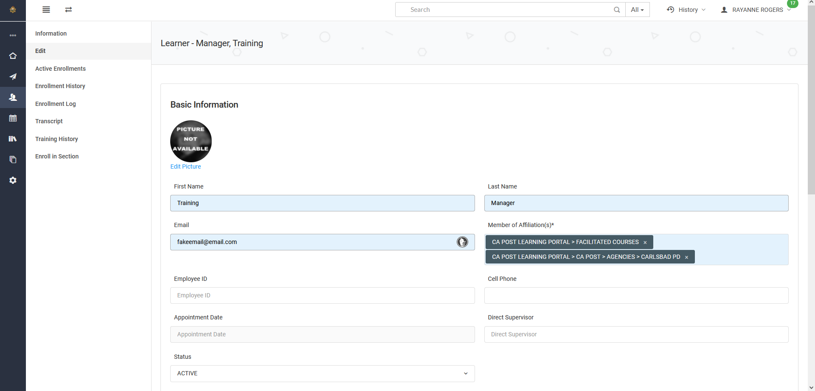
Organize Your Learners List
2. If multiple Affiliations, click the X to remove YOUR Affiliation, which removes them from YOUR list
2. Click Edit
1. Click Learners (search for Learner account to modify)
Notes:
Press ENTER
Click the Learners drop down arrow and select Learners.
Press ENTER
Click Edit.
Press ENTER
If Multiple affiliations, click the “X” to remove YOUR Affiliation, which removes them from your list.
Press ENTER

Slide 41
Organize Your Learners List
3. If they only have your Agency affiliation listed, and you know they are no longer part of your Agency, leave it and change status from Active to Archived.
Just Be Sure!
Notes:
Press ENTER
If the learner does not have multiple Affiliations and you know they are no longer part of your Agency, change the status from Active to Archived.
Press ENTER
JUST BE SURE!
Press ENTER

Slide 42
Organize Your Learners List
There MUST be an affiliation listed to archive the learner.
Notes:
Press ENTER
There must be an affiliation listed to archive the learner.
Press ENTER

Slide 43
Activity
Assign/Enroll Individuals and Groups in Training
Notes:
Now we are moving into Assigning /Enrolling individuals and Groups into Training.
Press ENTER

Slide 44
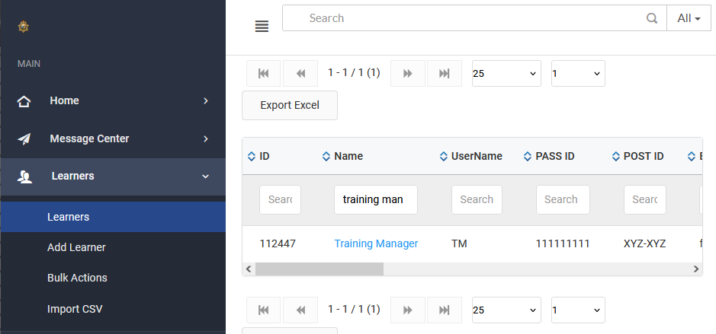
STEPS: Assign/Enroll Individuals
From Learners, find the person to assign training to
Click on the Learner’s name
Notes:
Press ENTER
From Learners, find the person to assign training to.
Press ENTER
Click on the Learner’s name.
Press ENTER

Slide 45
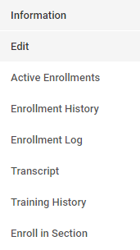
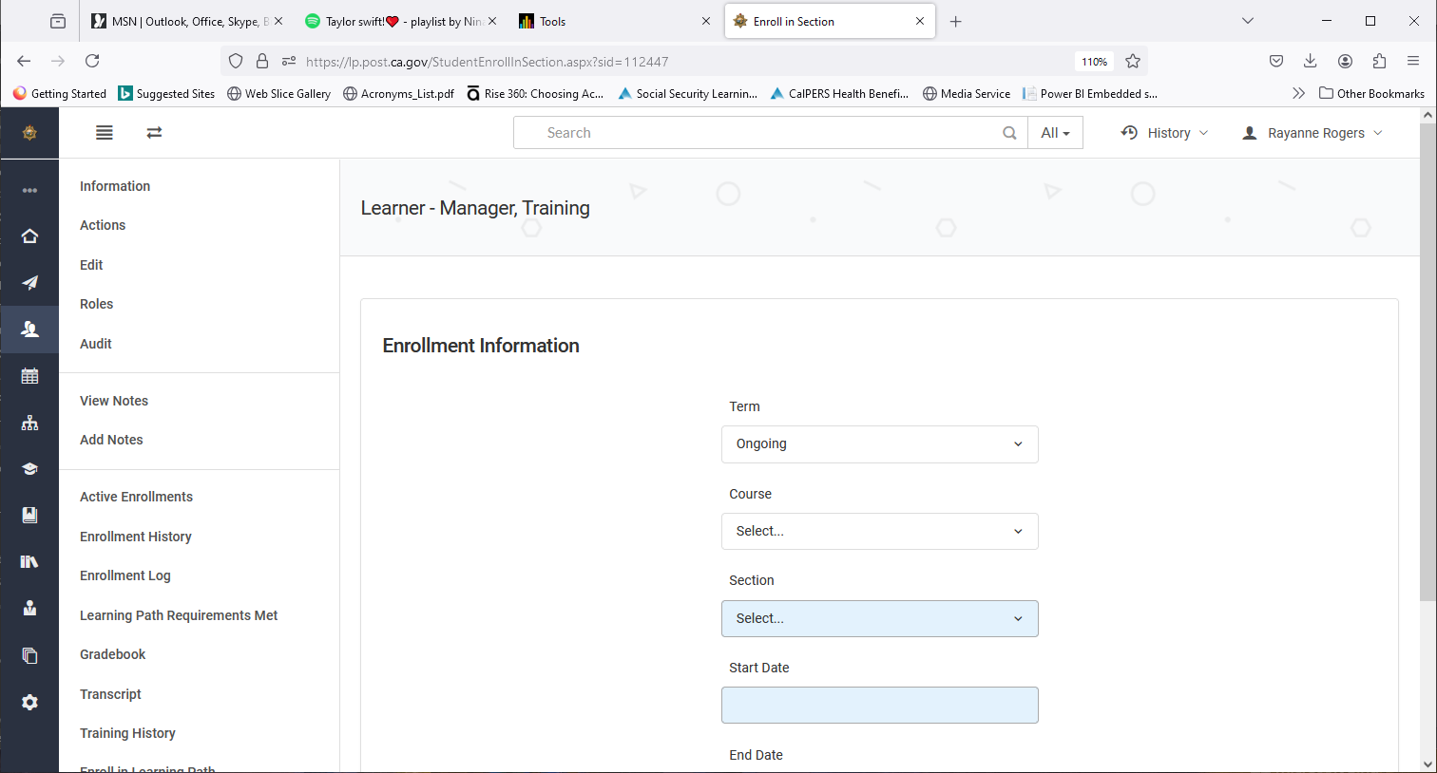
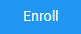
STEPS: Assign/Enroll Individuals (Con’t)
In the Learner’s details, from the left menu, click Enroll in Section
Select the current Term, the Title under Course, and the current Section
Enter Start and End dates
Scroll down and Click Enroll
They will be notified via email and
in the Portal’s Message Center
3. Enroll in Section
Notes:
Press ENTER
In the Learner’s details, from the left menu, click Enroll in Section.
Press ENTER
Select the current Term, The title under Course, and the current Section.
Press ENTER
Enter Start and End dates.
Press ENTER
Scroll down and Click Enroll.
Press ENTER
The learner will be notified via email and in the Portal’s Message Center.
Press ENTER

Slide 46
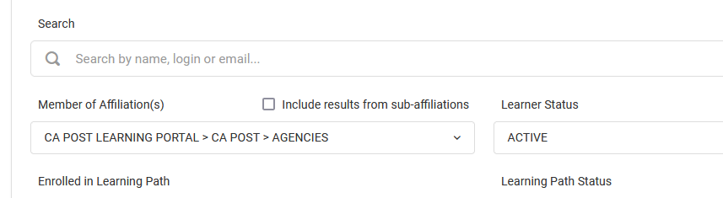
STEPS: Assign/Enroll Groups (Bulk Actions)
Under Learners, select Bulk Actions
From the Search Criteria, Select your Affiliation
Under Learner Status, click Active to help filter
Notes:
Press ENTER
Under Learners, select Bulk Actions.
Press ENTER
From the Search Criteria, select your Affiliation.
Press ENTER
Under Learner Status, click Active to help filter.
Press ENTER

Slide 47

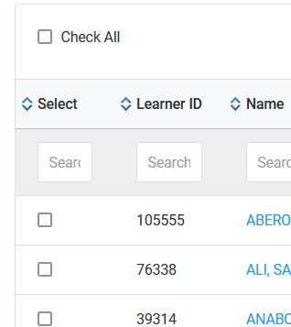
STEPS: Assign/Enroll Groups (Bulk Actions)
4. Scroll down. Click Get Data to bring up your agency
5. From that list, Check individuals or Check All
6. Scroll down and click Bulk Enroll
Notes:
Press ENTER
Scroll down. Click Get Data to bring up your Agency.
Press ENTER
From that list, check individuals that need to take training or check All.
Press ENTER
Scroll down and Click Bulk Enroll.
Press ENTER

Slide 48
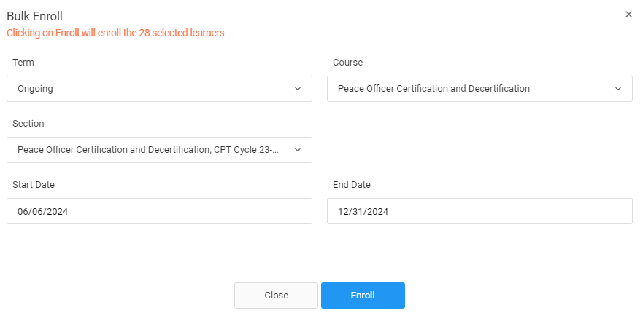
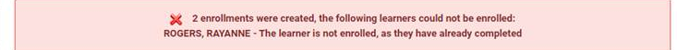
STEPS: Assign/Enroll Groups (Bulk Actions)
From the Bulk Enroll window, find the Course and Section
Select start and end dates
Click Enroll
An email will be sent telling the Learner they are enrolled
If they have already completed, a red info message appears
Notes:
Press ENTER
From the Bulk Enroll window, find the Course and Section.
Press ENTER
Select start and end dates.
Press ENTER
Click Enroll.
Press ENTER
An email will be sent telling the Learner they are enrolled.
Press ENTER
If they have already completed the course, a red information message appears. A green confirmation message will appear for those who have not taken the course yet.
Press ENTER

Slide 49
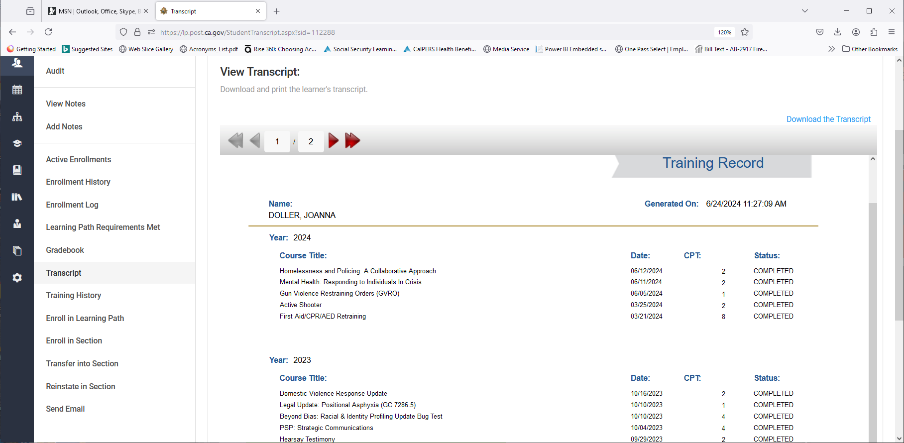
STEPS: Other Bulk Actions
“Get Transcripts PDF” button might be another valuable Bulk Action for you
Notes:
Press ENTER
Get Transcripts PDF button might be another valuable Bulk Action for you.
Press ENTER

Slide 50
Activity
Run Reports
Notes:
Next we will discuss running reports.
Press ENTER

Slide 51
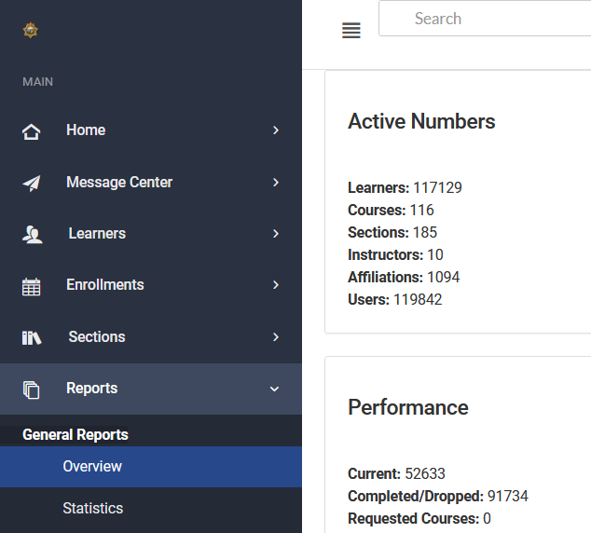
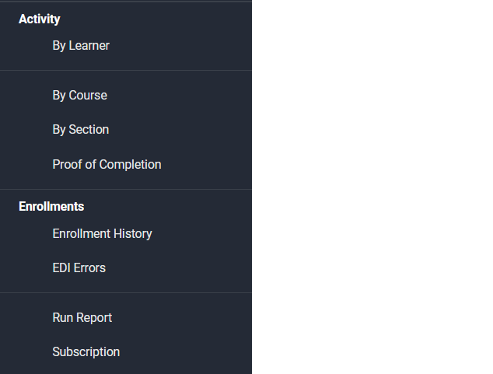
STEPS: Run Reports
From Manager Dashboard, Click Reports
Scroll down to Run Report
1. Reports
2. Run Report
Notes:
Press ENTER
From Manager Dashboard, click Reports.
Press ENTER
Scroll down to Run Report.
Press ENTER

Slide 52
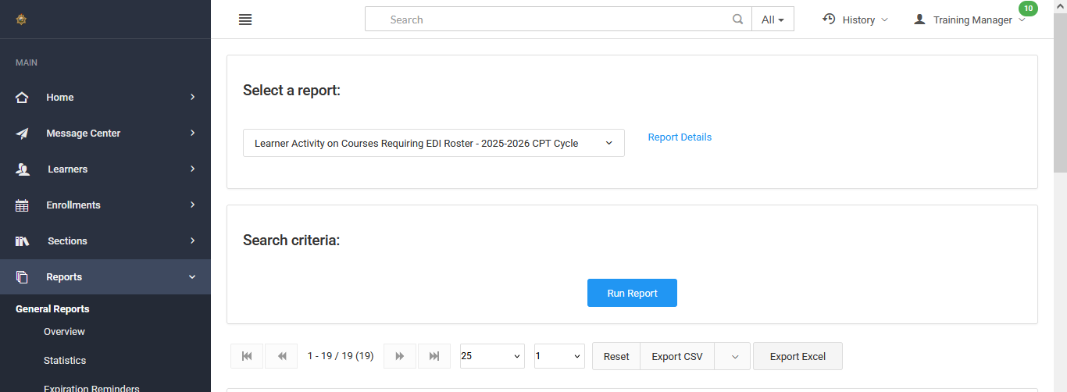
STEPS: Run Reports
3. Learner Activity Report …Requiring EDI Roster…
4. Run Report
5. Export to Excel
Notes:
Press ENTER
Select Report…Learner Activity Report Requiring an EDI Roster.
Press ENTER
Run Report
Press ENTER
Export to Excel
Press ENTER

Slide 53
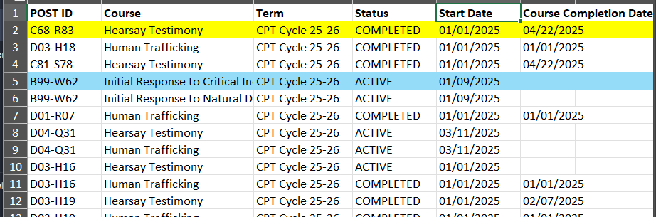
STEPS: Run Reports
Completed in Portal Needs EDI roster added
Still Enrolled / In Progress
Notes:
Press ENTER
For courses completed in the Portal, you will need to known which courses require a roster for course completion. Note: the report in Excel will not color code for you automatically.
Press ENTER
Active = still enrolled or In Progress.
Press ENTER

Slide 54
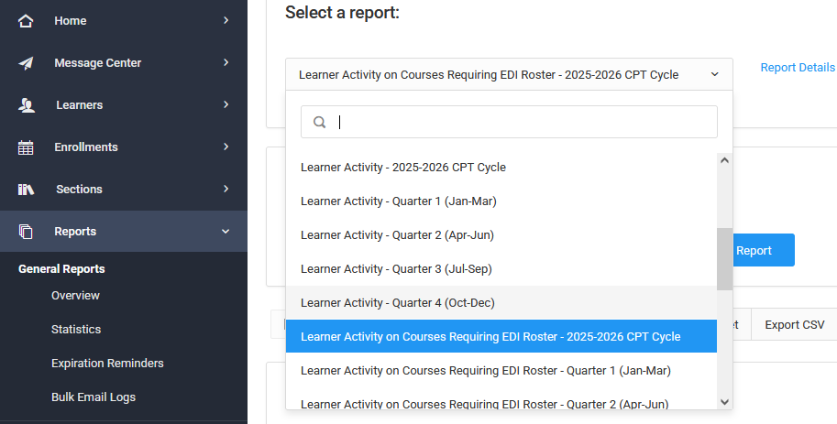
STEPS: Run Reports
Use reports with “Learner Activity” in title
Notes:
Press ENTER
Use reports with Learner Activity in title
Press ENTER

Slide 55
Activity
How the Course Customization
(VPP) Works
Notes:
How many of you have completed the VPP course customization for your Agency?
How did it go?
Press ENTER

Slide 56

Overview of VPP Customization Module
Select Vehicle
Pursuit Policy
Customization Module
Notes:
If you are a LP Admin with Manager access you have been assigned the VPP CM, go to your Dashboard to locate the VPP and open the CM. Have a copy of your agency’s pursuit policy in PDF form ready.
Press ENTER
Select Vehicle Pursuit Policy Customization Module tile from your Dashboard.
Press ENTER

Slide 57

Vehicle Pursuit Policy Customization Module and Course Info
Annual mandate for Vehicle Pursuit Policy training (PC 13519.8)
Customization module is automatically assigned to Training Managers with Admin Rights
LP Admins customize to match agency’s policy
TMs receive an enrollment email with a link
TMs need to:
  Log in and review the 3-minute
  orientation
  Open the customization module
  Upload a PDF version of policy, even it was
  uploaded before
  Review your customizations for accuracy
  Your progress will be saved
  Publish your customizations
Notes:
Press ENTER
Annual mandate for Vehicle Pursuit Policy training (PC13519.8).
Press ENTER
Customization module is automatically assigned to Training Managers with Admin Rights
Press ENTER
Training managers with Admin Rights can customize the course to match their agency’s policy
Press ENTER
TMs received an enrollment email with a link
Press ENTER
TMs will need to:
Press ENTER
Log in and review the CM info and 3-minute orientation
Press ENTER
Open the customization module.
Press ENTER
Upload a PDF version of your agency policy even if you had an uploaded file before
Press ENTER
Review and preview your customizations for accuracy. You can leave and return to the customization module.
Press ENTER
Your progress will be saved.
Press ENTER
Publish your customizations. The course will be available for registration in the catalog; however, learners will not be able to start the course until the customizations are published.

Slide 58

Overview of VPP Customization Module
Read through the FAQs and resources
Notes:
Press ENTER
Scroll and read through each of these sections such as the FAQs and Guidelines
Press ENTER

Slide 59


Overview of VPP Customization Module
Open the first block
Watch the 3-minute orientation
Start the customization
Notes:
Press ENTER
Open the first block and select the Orientation video
Have a PDF (under 30 MB) of your vehicle pursuit policy, upload your policy even it was uploaded before, then start the customization steps.
Press ENTER

Slide 60

Notes:
VPP Orientation. Click to play.
Does anyone want to watch the 3 minute orientation video?
Press ENTER

Slide 61
Activity
POST Facilitated Courses and Guides
Notes:
POST Facilitated Courses and Guides: This will show you how to complete the facilitation needed to complete the roster for EDI.
Press ENTER

Slide 62



POST Facilitated Courses
Find POST Facilitated Courses
Click Facilitated Courses Explained
Notes:
The POST Facilitated Courses tile now sits on your Dashboard for easier access.
Click on POST Facilitated Courses.
Press ENTER
Click Facilitated Courses explained. This will provide additional information for you to reference regarding what is needs to be completed before entering a roster into EDI.
Press ENTER
Close out using “X”.
Press ENTER

Slide 63
POST Facilitated Courses
POST Facilitated Courses
Titles in Alpha order or use Search
Notes:
Press ENTER
Search for title either alpha order or search function.
Press ENTER
Click overview/guides for facilitation documentation and student guide.
Click to start Active Shooter training.
Press ENTER
Main Menu for Active Shooter.
Notice Facilitator Mode provides access to freely navigate through the course.
Press ENTER

Slide 64



Guides
Training
Notes:
This is a video from Active Shooter.
Press ENTER

Slide 65
POST Facilitated Courses List
To get back, click the X
Notes:
Press ENTER
To return to the Dashboard, click the “X”.
Press ENTER

Slide 66

POST Facilitated Courses List
Click Tools then Genius Dashboard
Notes:
Press ENTER
Tools, then Genius Dashboard to get back to the dashboard.
Press ENTER

Slide 67
Activity
How to Give Credit in EDI when Rosters are Required
Notes:
But how do you know which courses need a roster? You may need to cross refence courses in the Portal catalog which identify “Roster Required”.
Press ENTER

Slide 68

Notes:
Click to play video.
Log into your EDI account at https://edinet.post.ca.gov/home.aspx
Under GENERAL QUICK LINKS section at left, select Course Rosters (or from the top header drop-down menus, select Courses then select Rosters.)
Select Enter Roster on Behalf of: (Select Agency/Presenter from drop-down)
Select POST MULTI-MEDIA COURSE (Cert # 29000)
Select the Presentation Title (you can sort titles A-to-Z by clicking at the top of the column)
Follow prompts to complete the Course Roster
Press ENTER

Slide 69
Entering POST Facilitated Training Videos (Multimedia) Course Rosters into EDI
Written Instructions
https://post.ca.gov/portals/0/post_docs/training/TrainingVideoCourseRosters_Instructions.pdf
Log into your EDI account at https://edinet.post.ca.gov/home.aspx
Under GENERAL QUICK LINKS section at left, select Course Rosters (or from the top header drop-down menus, select Courses then select Rosters.)
Select Enter Roster on Behalf of: (Select Agency/Presenter from drop-down)
Select POST MULTI-MEDIA COURSE (Cert # 29000)
Select the Presentation Title (you can sort titles A-to-Z by clicking at the top of the column)
Follow prompts to complete the Course Roster
Notes:
The instructions from the link at the top of the page are on how to enter an EDI roster for the Hybrid/Facilitated course topics.
NOTE: You can only enter one at a time.
Press ENTER

Slide 70
Let’s Review
How do you switch between your Learner and Manager views?
How do you enroll/assign training?
How do you run a report of course completions?
Where do you find information on how to enter a roster in EDI for the facilitated video courses, so Learners get CPT credit?
Notes:
Take 5 minutes to answers these questions
Press ENTER

Slide 71
Review
How do you switch between your Learner and Manager views?
After log in, from the left panel, click the arrow next to “Learner” and switch to “Manager.” As a Manager, click the dropdown menu on the right and select Learner.
Notes:
How do you switch between your Learner and Manager views?
Press ENTER
After log in, from the left panel, click the arrow next to “Learner” and switch to “Manager”. As a Manager, click the dropdown menu on the right and select Learner.
Press ENTER

Slide 72
Review
How do you enroll/assign training?
Individual: Find the learner, click Enroll in Section, select the course and section, set the start and end dates (if needed), and enroll.
Group: Go to Bulk Actions, get the list of learners, select the learners to assign, click Bulk Enroll, then select the course and section and set the start and end dates (if needed), and enroll.
Notes:
How do you enroll/assign training?
Press ENTER
Individual: Find a learner, click Enroll in Section, select the course and section, set the start and end dates (if needed), and enroll.
Group: Go to Bulk Actions, get the list of learners, select the learners to assign, click Bulk Enroll, then select the course and section and set the start and end dates (if needed), and enroll.
Press ENTER

Slide 73
Review
How do you run reports?
Go to Reports > Run Report.
Select a report that starts with “Learner Activity”.
Click Run Report button and Export to Excel.
Notes:
How do you run reports?
Press ENTER
Go to Reports > Run Report.
Select a report that starts with “Learner Activity”.
Click Run Report button and export to Excel.
Press ENTER

Slide 74
Review
How do you enter a roster in EDI for the facilitated video courses, so Learners get CPT credit?
Log into EDI account > Click General Quick Links.
Select Courses > Select Rosters > Select Enter Roster on Behalf of.
Select POST MULTI-MEDIA COURSE > Select Presentation Title.
Follow remaining prompts.
Or go to: https://post.ca.gov/portals/0/post_docs/training/TrainingVideoCourseRosters_Instructions.pdf
Notes:
How do you enter a roster in EDI for the facilitated video courses, so Learners get CPT credit?
Press ENTER
Log into EDI account > Click General Quick Links.
Select Courses > Select Rosters > Select Enter Roster on Behalf of.
Select POST MULTI-MEDIA COURSE > Select Presentation Title.
Follow remaining prompts.
Or go to: https://post.ca.gov/portals/0/post_docs/training/TrainingVideoCourseRosters_Instructions.pdf
Press ENTER

Slide 75


Stay Informed!
  Sign up to receive the Learning Portal quarterly newsletter
  Go to the POST web page (www.post.ca.gov)
  Sign in to PASS, if needed
  Open “Your PASS” account, under your name
  Click the Subscriptions Tab
Notes:
Press ENTER

Slide 76
Where to Find Help
Training Managers Page on POST Website
-- Portal Tutorials and Access Instructions
-- Plus, this PowerPoint https://post.ca.gov/training-managers
Quick Reference Guide – Download/Print
https://post.ca.gov/learning-technology-resources
Notes:
Use these links for more information
Take some time to review the contents of the TM page.
Press ENTER
Training Managers Page on POST Website:
Portal Tutorials and Access Instructions
Plus this PowerPoint
Press ENTER
Quick Reference Guide that can be downloaded and printed.
Press ENTER

Slide 77
Where to Find Help
Contact the Support Team for Help
support@postportal.atlassian.net or 916-970-4650
Entering Rosters for Facilitated Training Videos
Entering Rosters into EDI Instructions
Learning Portal Administration/Manager
Fill out POST Website Form 2-339
Learning Portal Trainings that Meet Mandates
These Portal Trainings Meet Mandates
Notes:
Contact the Support Team. When contacting Support, please provide as much information as possible.
Entering Rosters for Facilitated Training Videos
Learning Portal Administration/Manager Form 2-339
Learning Portal Trainings that Meet Mandates

Slide 78

Any Questions?

